Slide 1
AZURE AZ 900

Slide 2
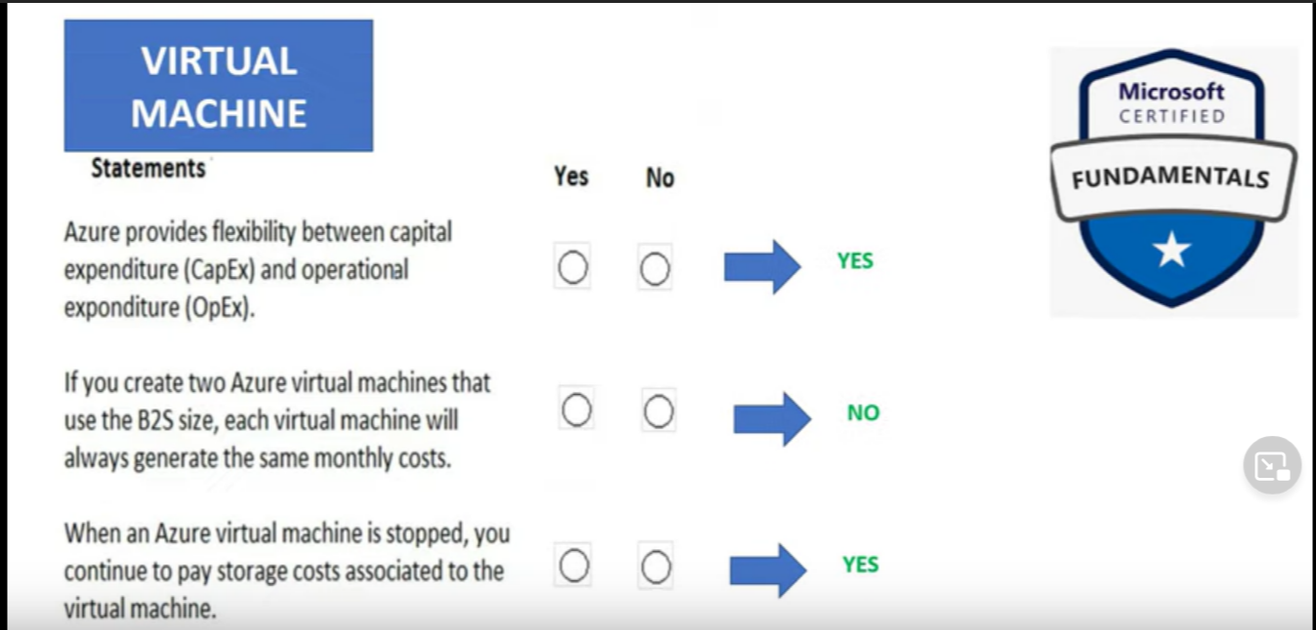

Slide 3
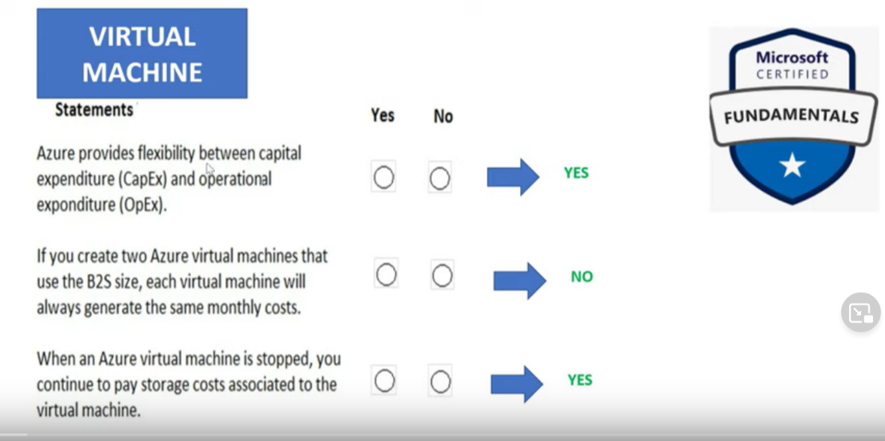

Slide 4
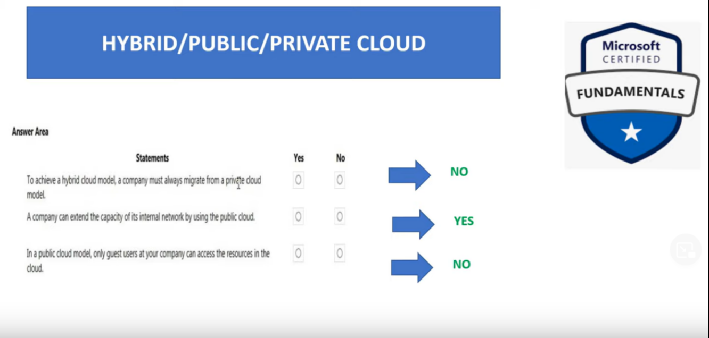

Slide 5
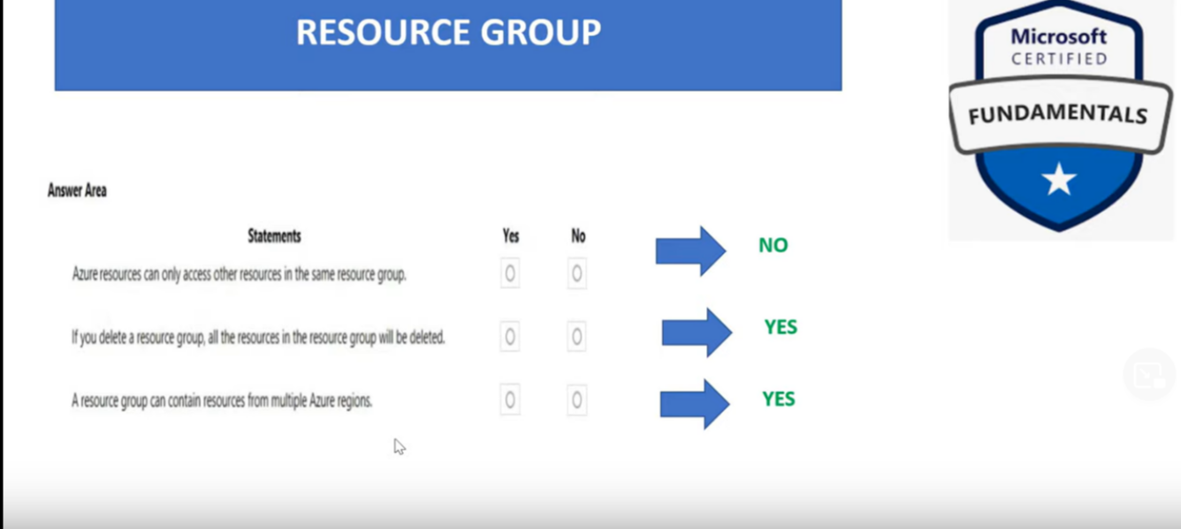

Slide 6
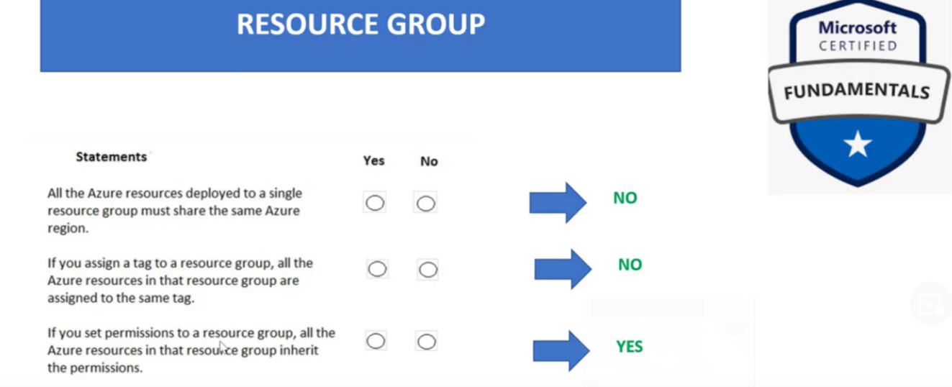

Slide 7
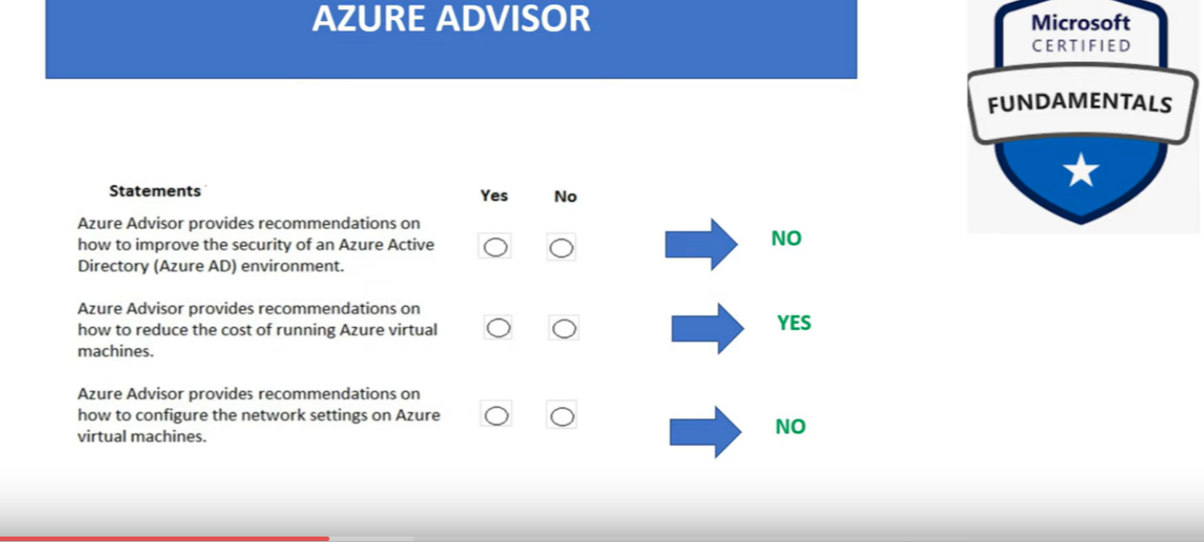

Slide 8
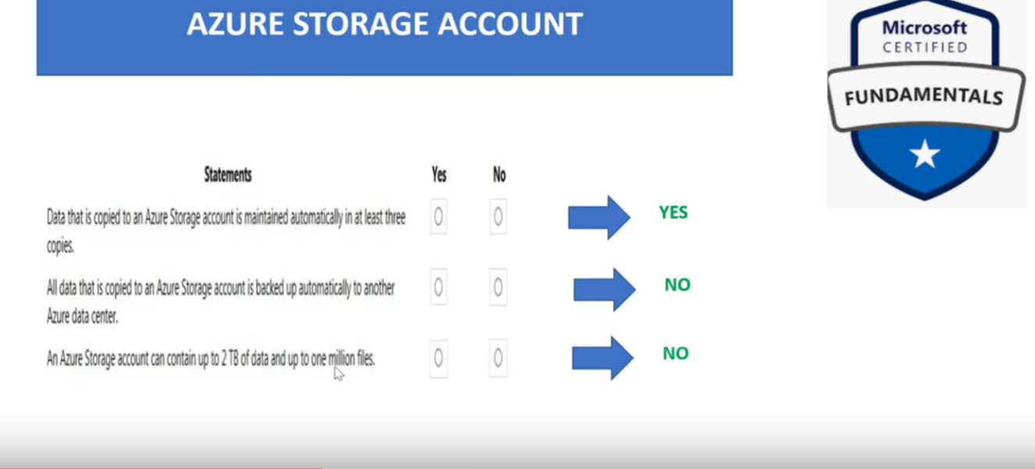

Slide 9
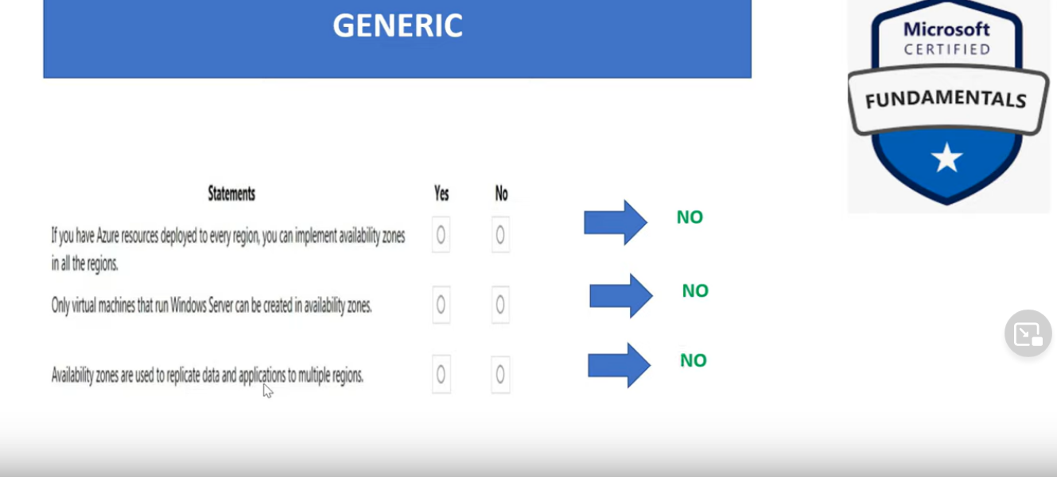
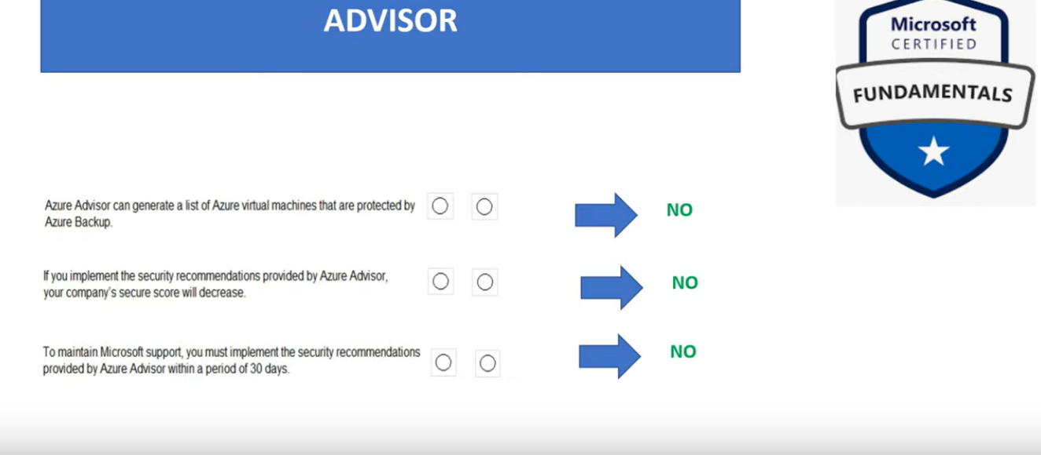

Slide 10
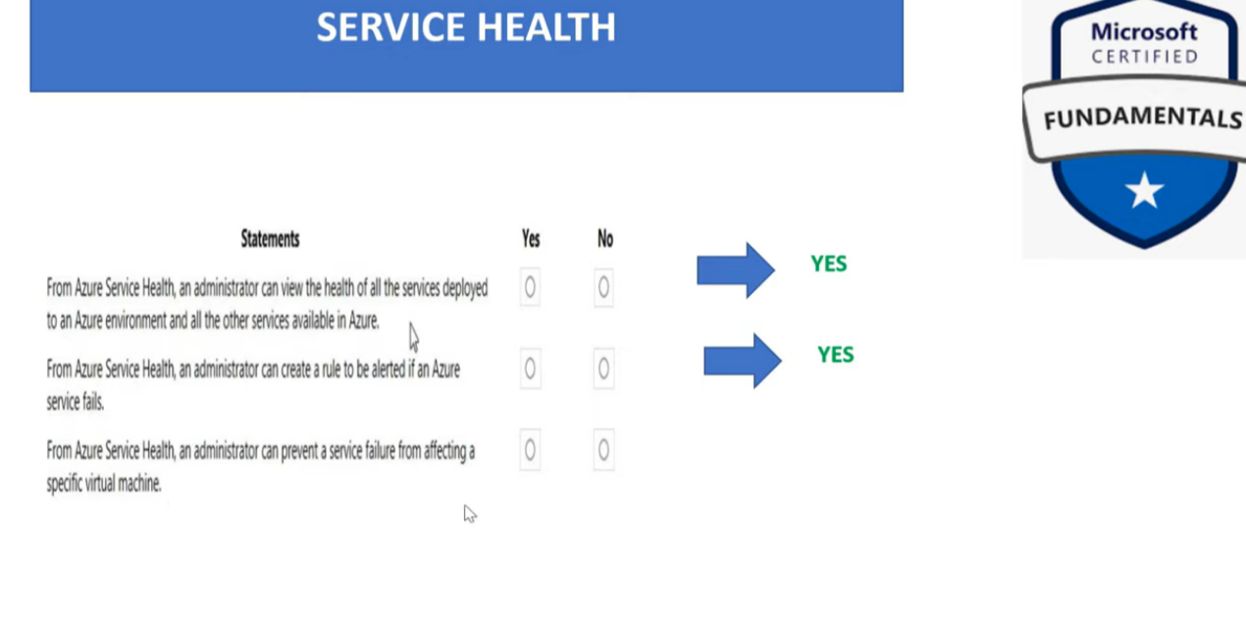

Slide 11
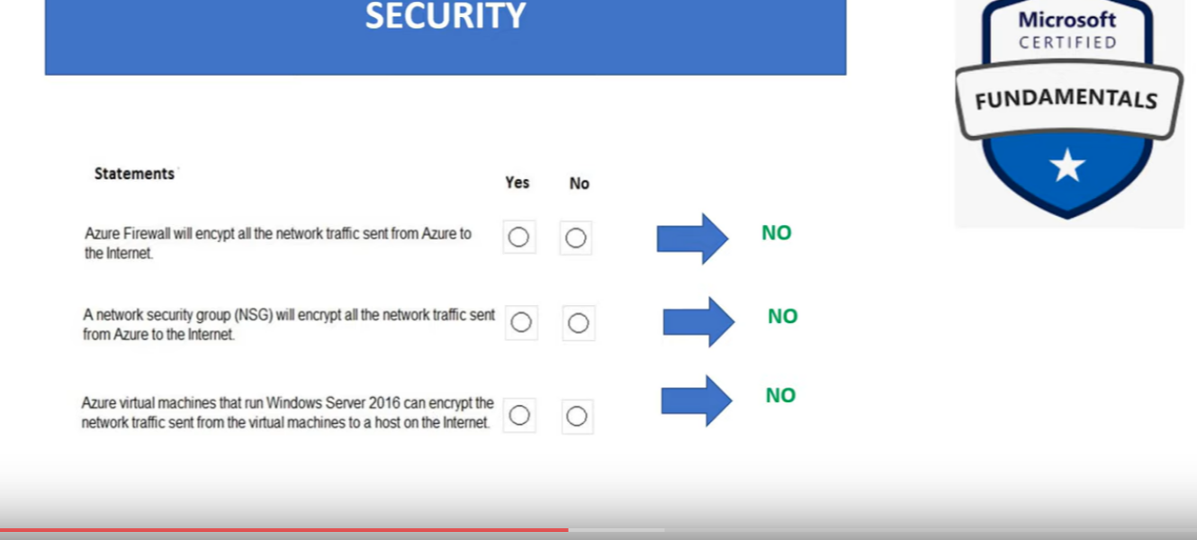
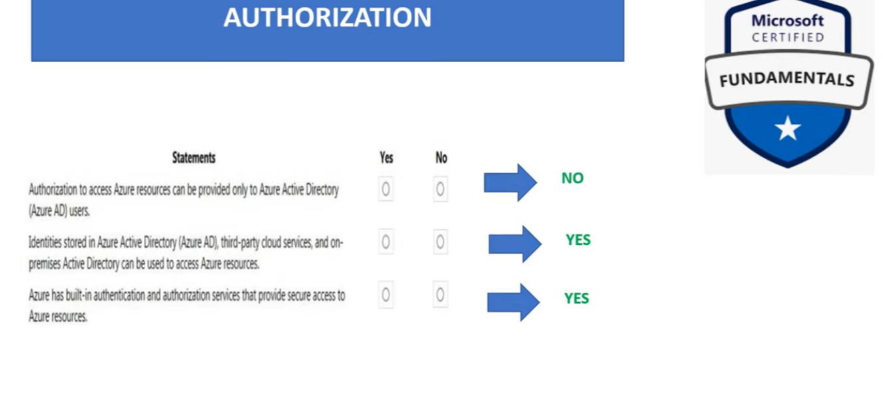

Slide 12
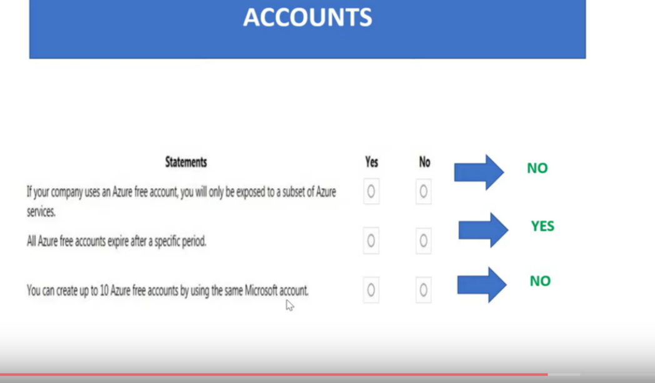

Slide 13
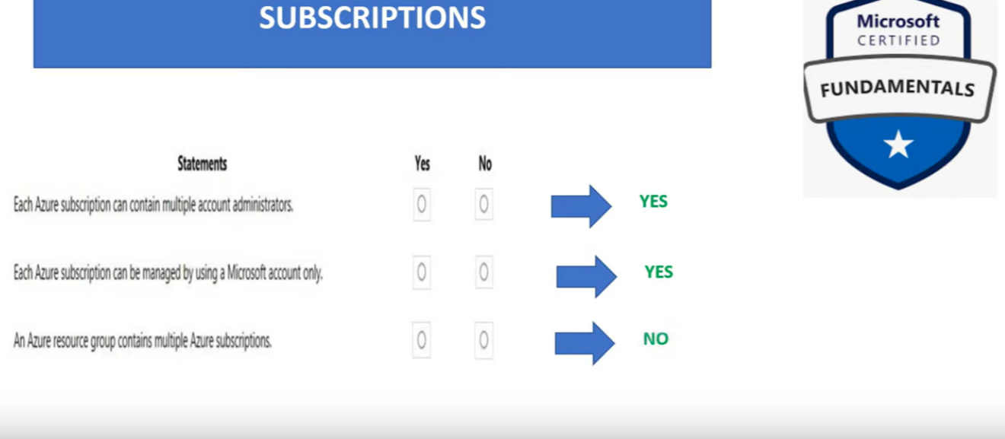

Slide 14
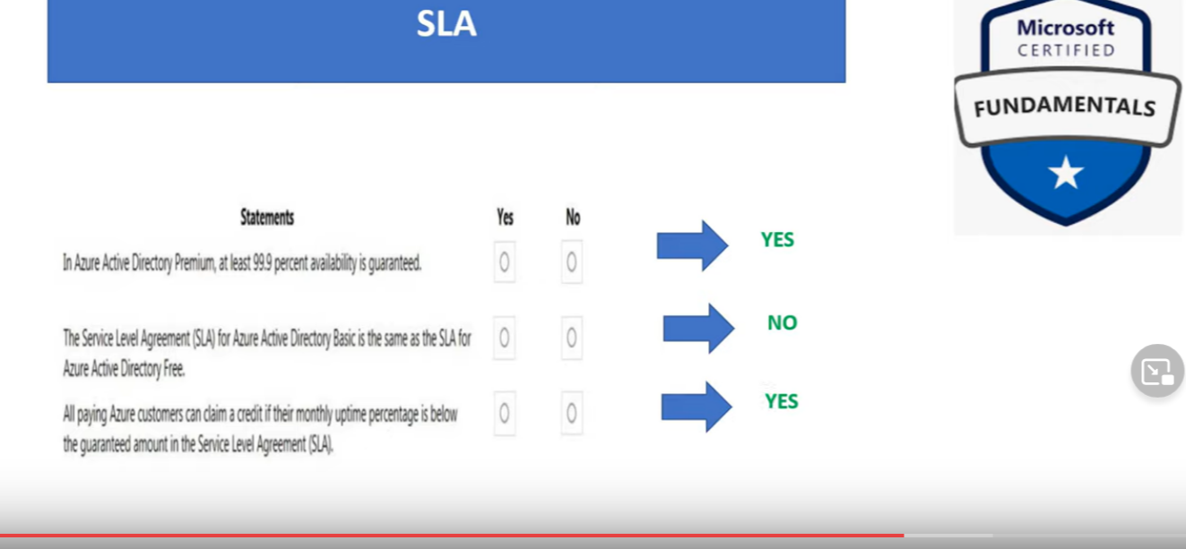

Slide 15
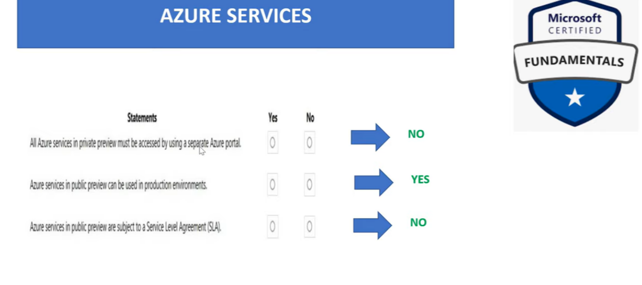

Slide 16
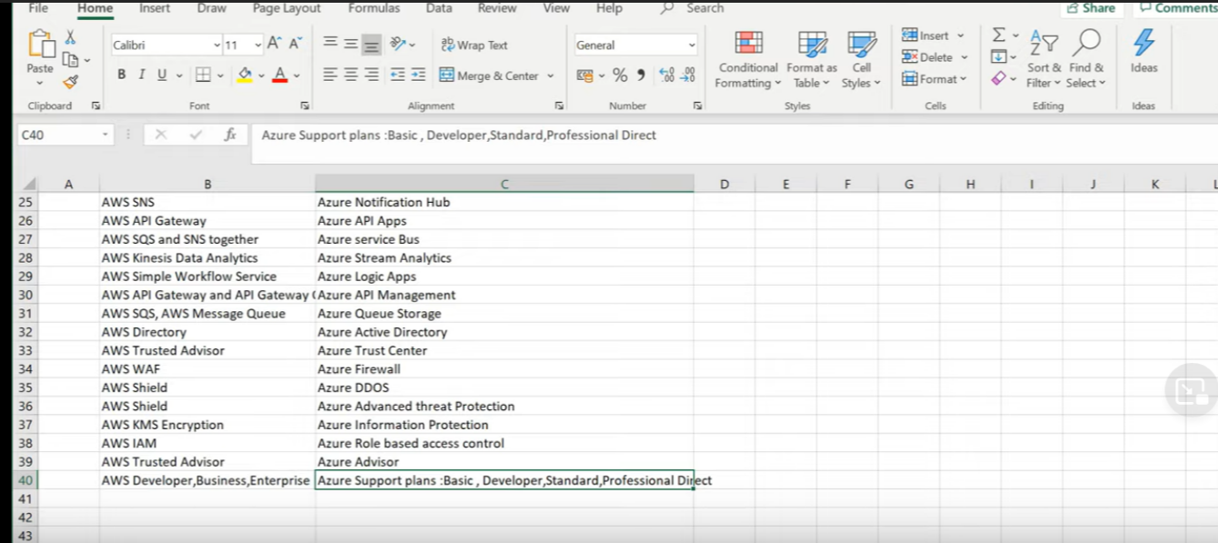

Slide 17
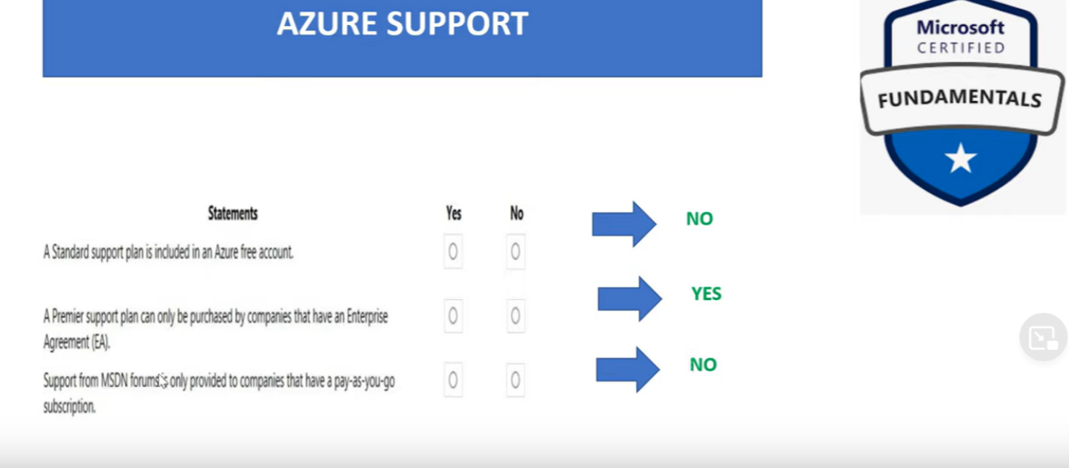

Slide 18
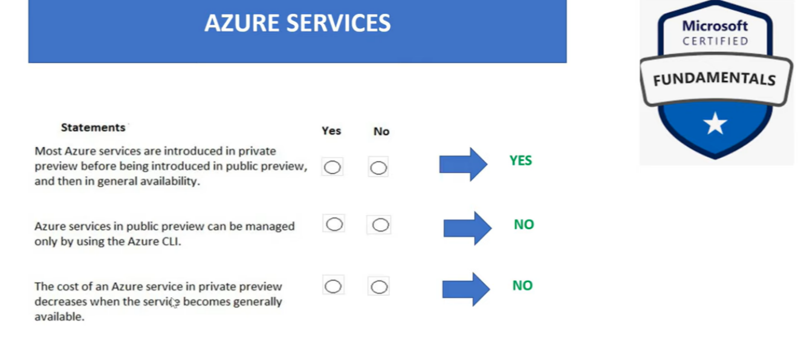

Slide 19


Slide 20
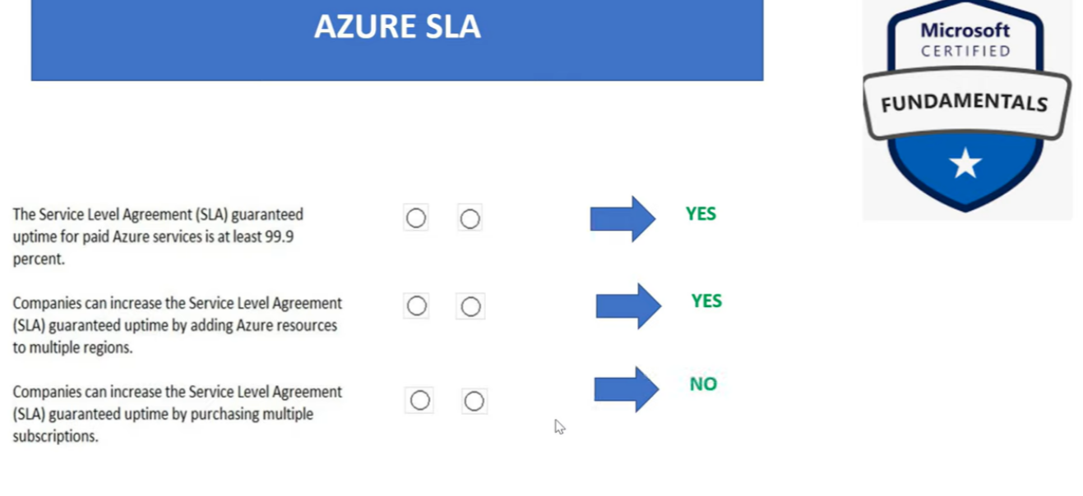

Slide 21
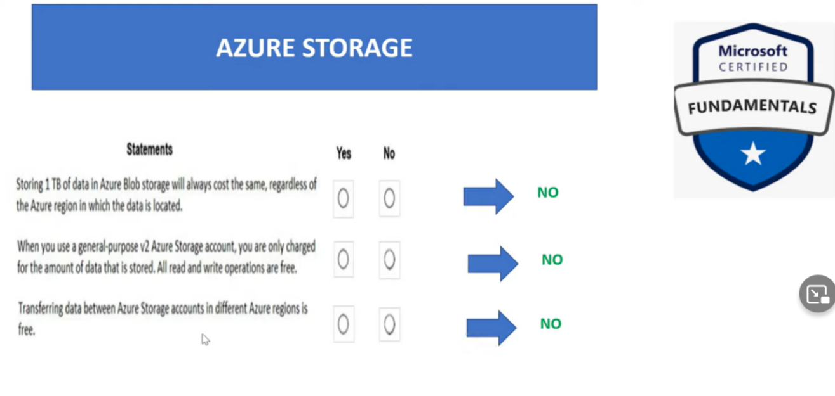

Slide 22
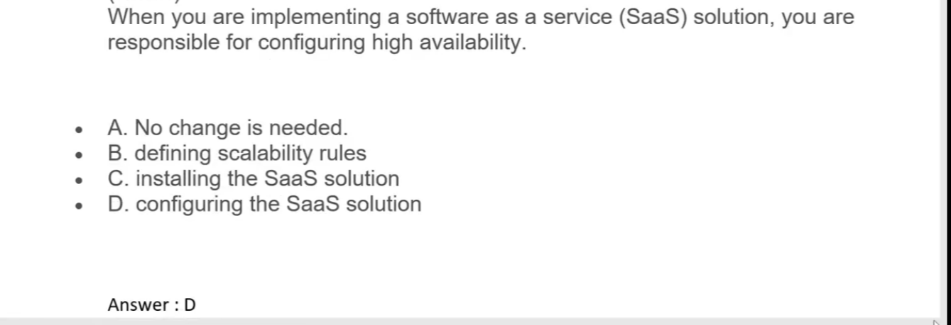

Slide 23
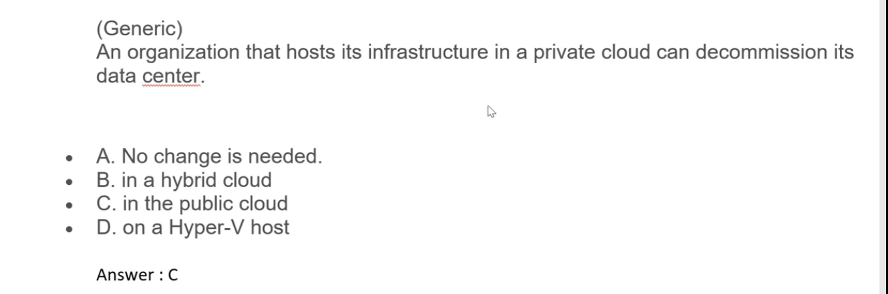

Slide 24
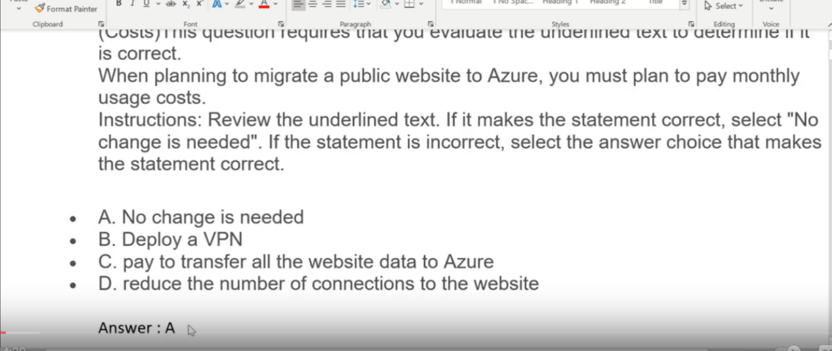

Slide 25
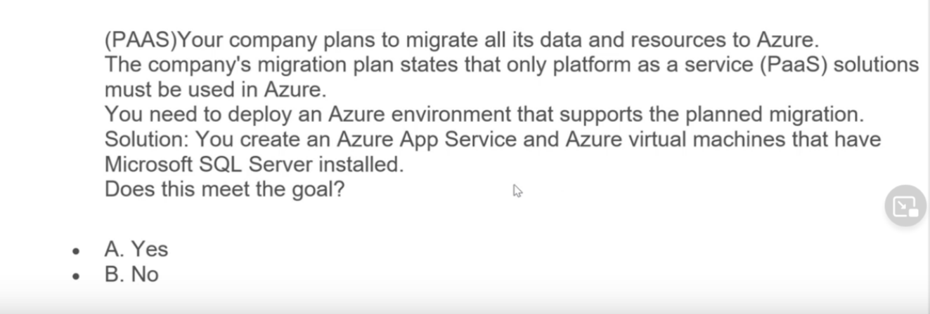


Slide 26
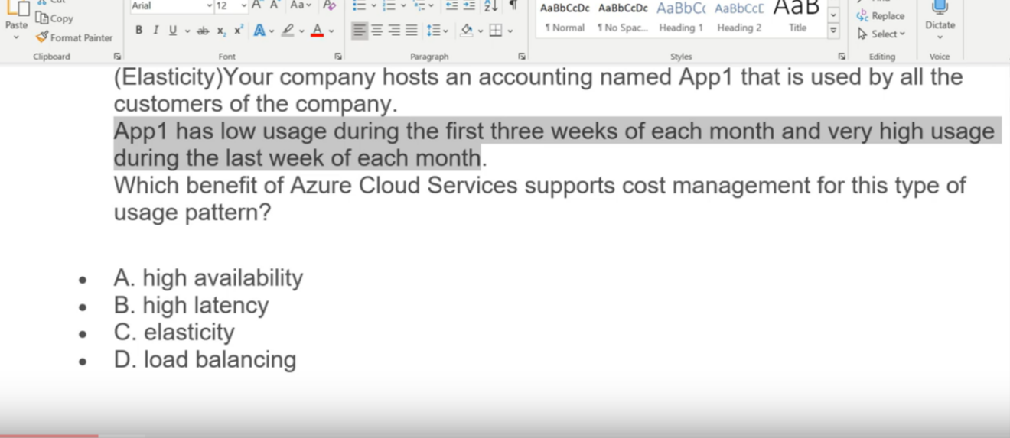


Slide 27
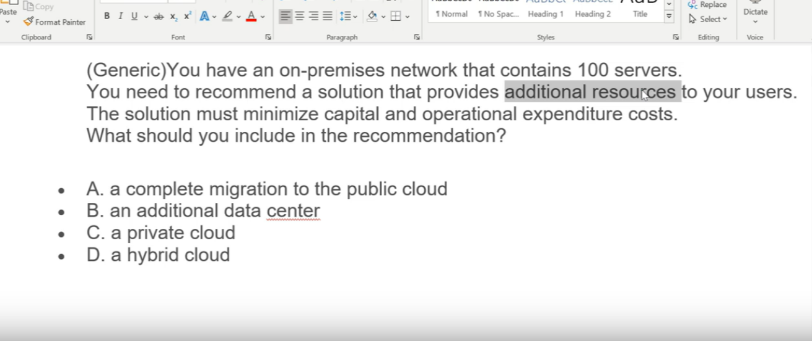


Slide 28
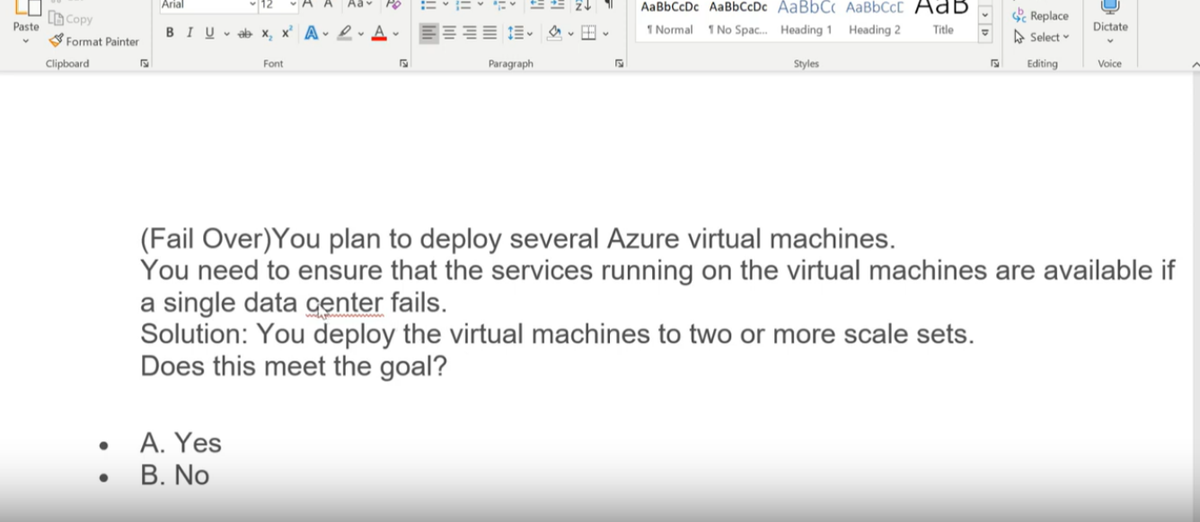


Slide 29
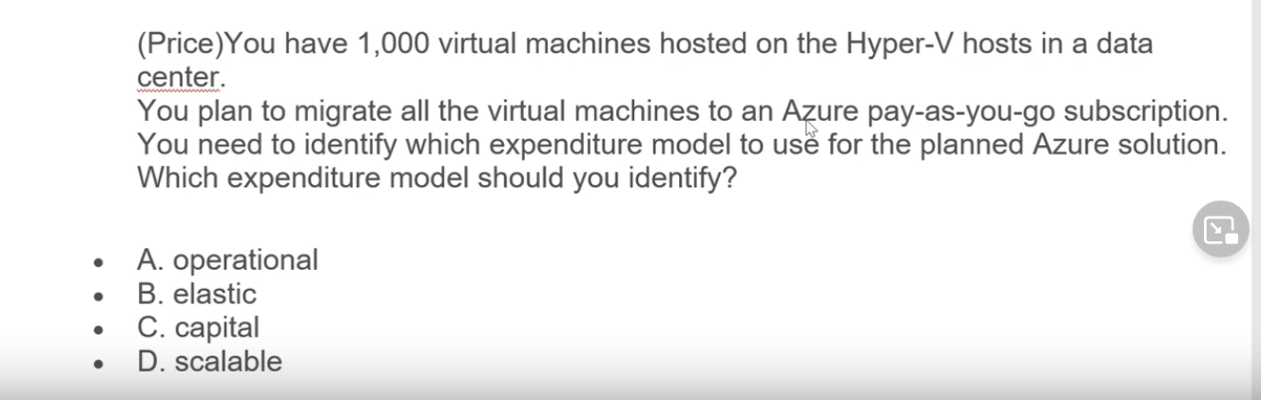



Slide 30
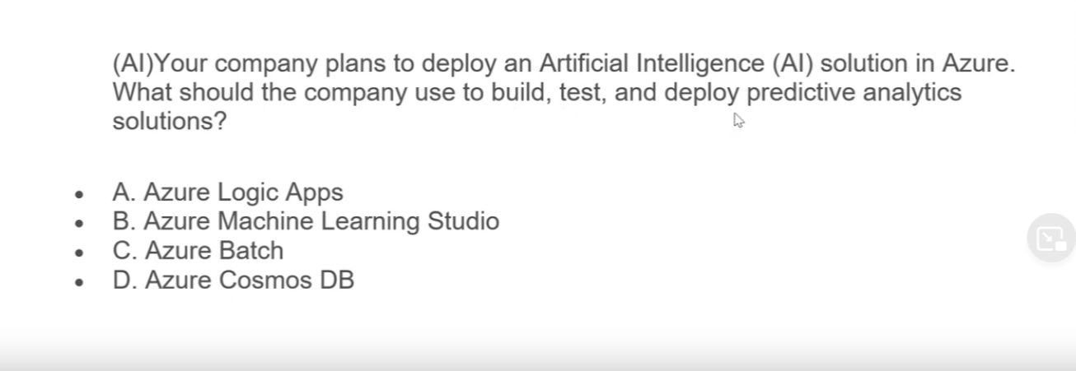


Slide 31
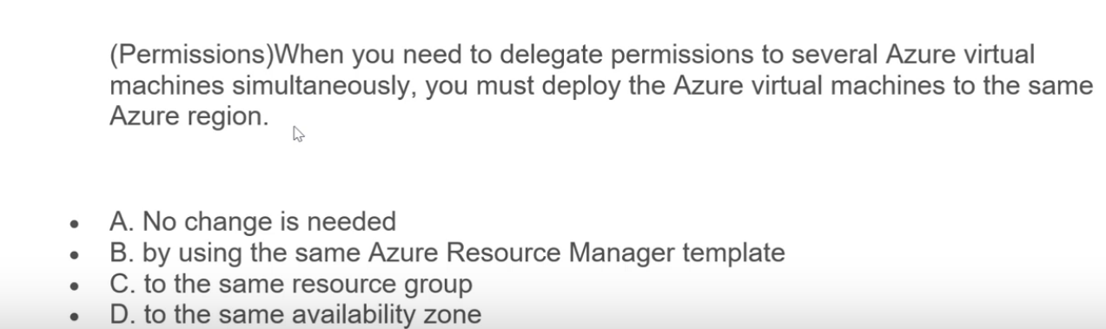


Slide 32
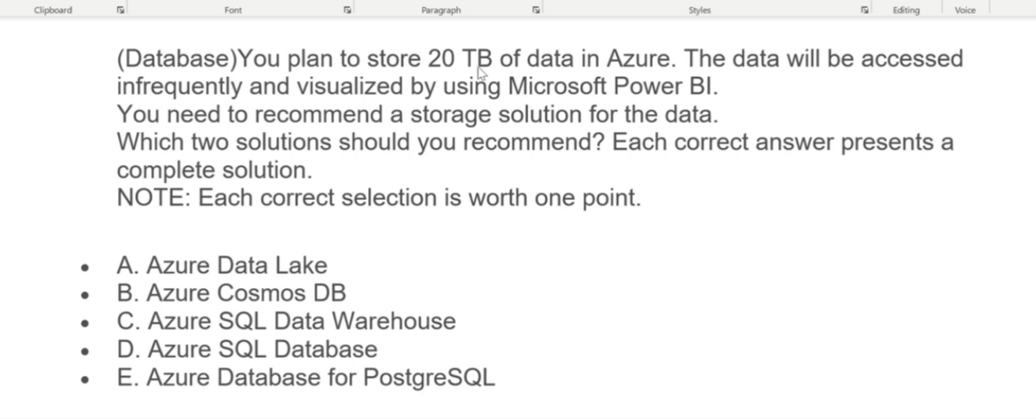


Slide 33
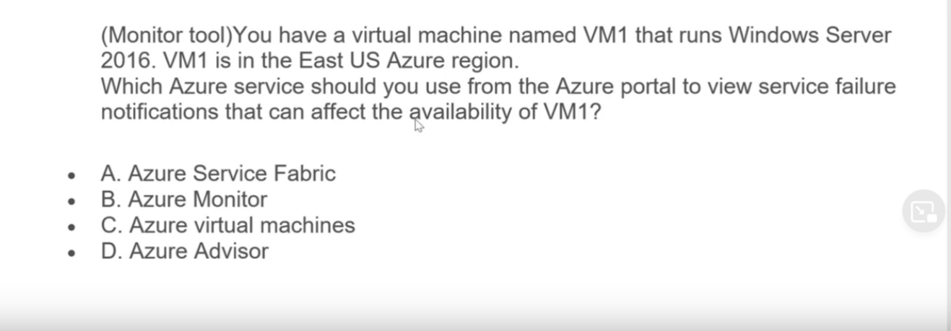


Slide 34
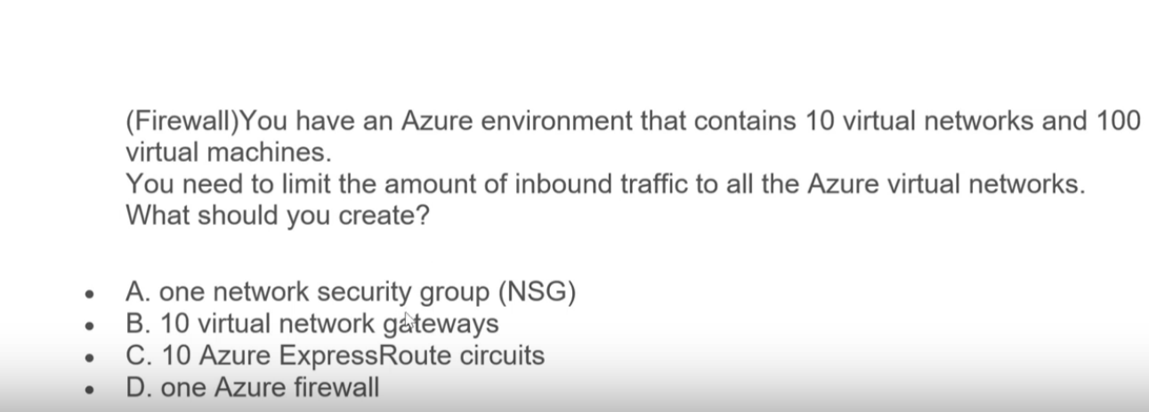


Slide 35
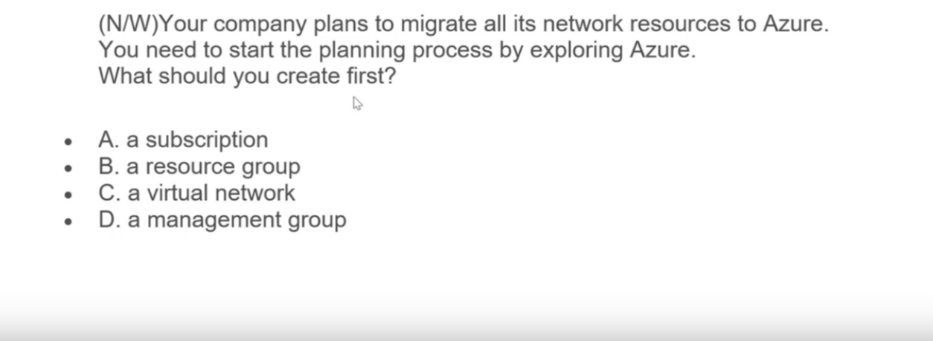
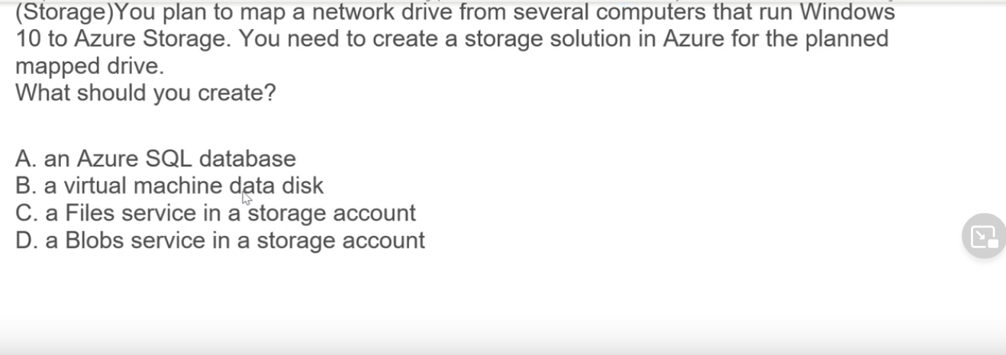



Slide 36
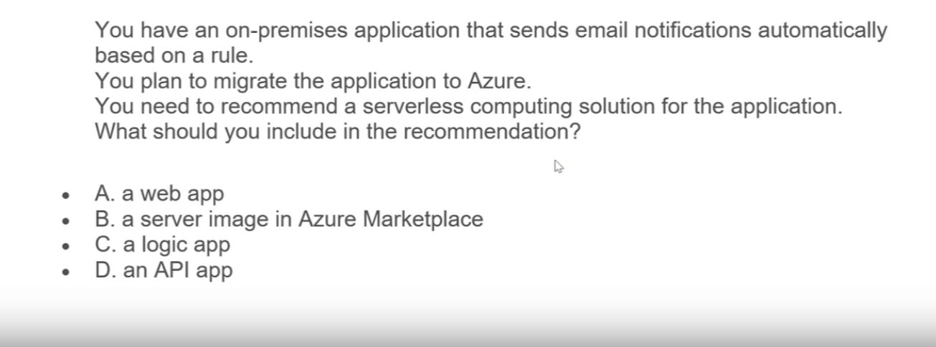



Slide 37
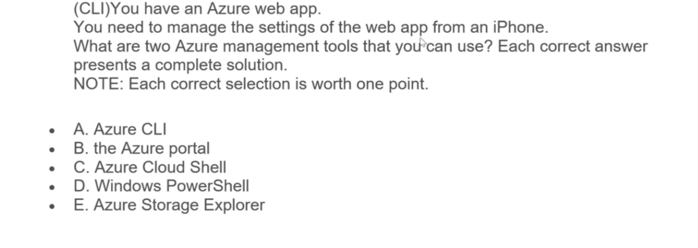



Slide 38
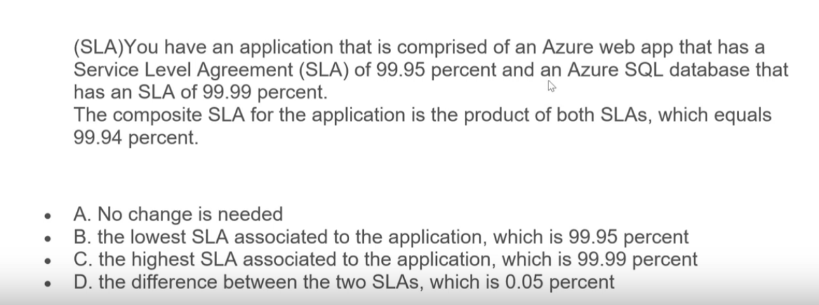


Slide 39
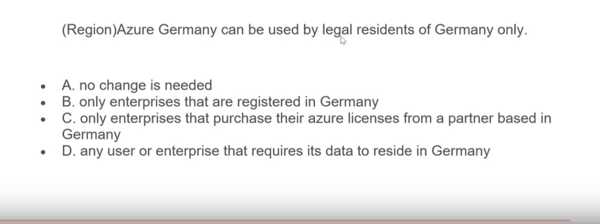

Slide 40
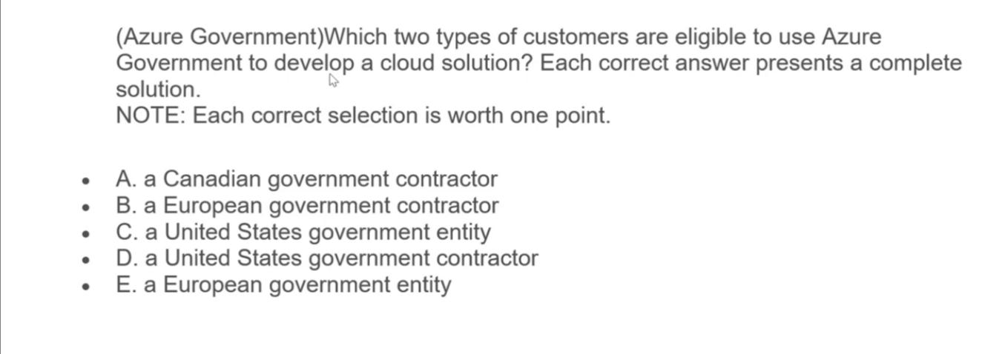

Slide 41
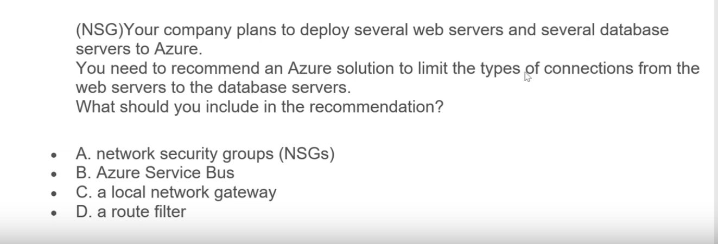

Slide 42
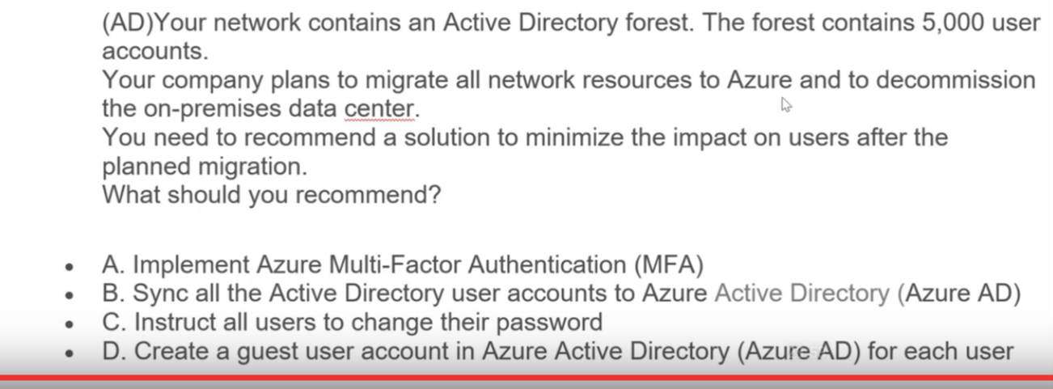

Slide 43
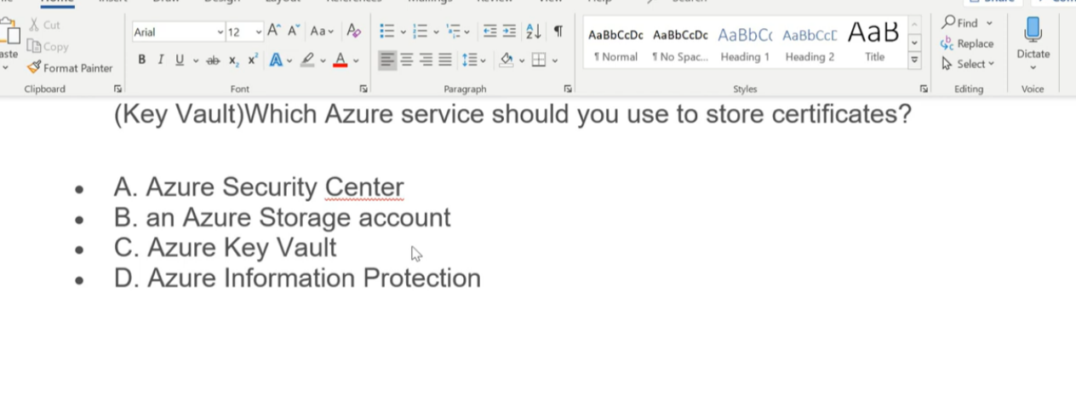
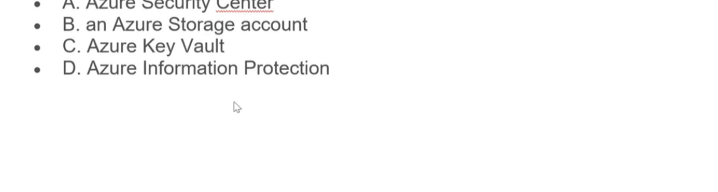


Slide 44
Azure Functions
When you're concerned only about the code running your service, and not the underlying platform or infrastructure, using Azure Functions is ideal. Functions are commonly used when you need to perform work in response to an event (often via a REST request), timer, or message from another Azure service, and when that work can be completed quickly, within seconds or less.
Functions scale automatically based on demand, so they're a solid choice when demand is variable. For example, you might receive messages from an IoT solution that's used to monitor a fleet of delivery vehicles. You'll likely have more data arriving during business hours.
Using a virtual machine-based approach, you'd incur costs even when the virtual machine is idle. With functions, Azure runs your code when it's triggered and automatically deallocates resources when the function is finished. In this model, you're only charged for the CPU time used while your function runs.
Functions can be either stateless or stateful. When they're stateless (the default), they behave as if they're restarted every time they respond to an event. When they're stateful (called Durable Functions), a context is passed through the function to track prior activity.
Functions are a key component of serverless computing. They're also a general compute platform for running any type of code. If the needs of the developer's app change, you can deploy the project in an environment that isn't serverless. This flexibility allows you to manage scaling, run on virtual networks, and even completely isolate the functions.

Slide 45
Azure Logic Apps
Logic apps are similar to functions. Both enable you to trigger logic based on an event. Where functions execute code, logic apps execute workflows that are designed to automate business scenarios and are built from predefined logic blocks.
Every Azure logic app workflow starts with a trigger, which fires when a specific event happens or when newly available data meets specific criteria. Many triggers include basic scheduling capabilities, so developers can specify how regularly their workloads will run. Each time the trigger fires, the Logic Apps engine creates a logic app instance that runs the actions in the workflow. These actions can also include data conversions and flow controls, such as conditional statements, switch statements, loops, and branching.
You create logic app workflows by using a visual designer on the Azure portal or in Visual Studio. The workflows are persisted as a JSON file with a known workflow schema
With Functions, you write code to complete each step.
With Logic Apps, you use a GUI to define the actions and how they relate to one another.

Slide 46
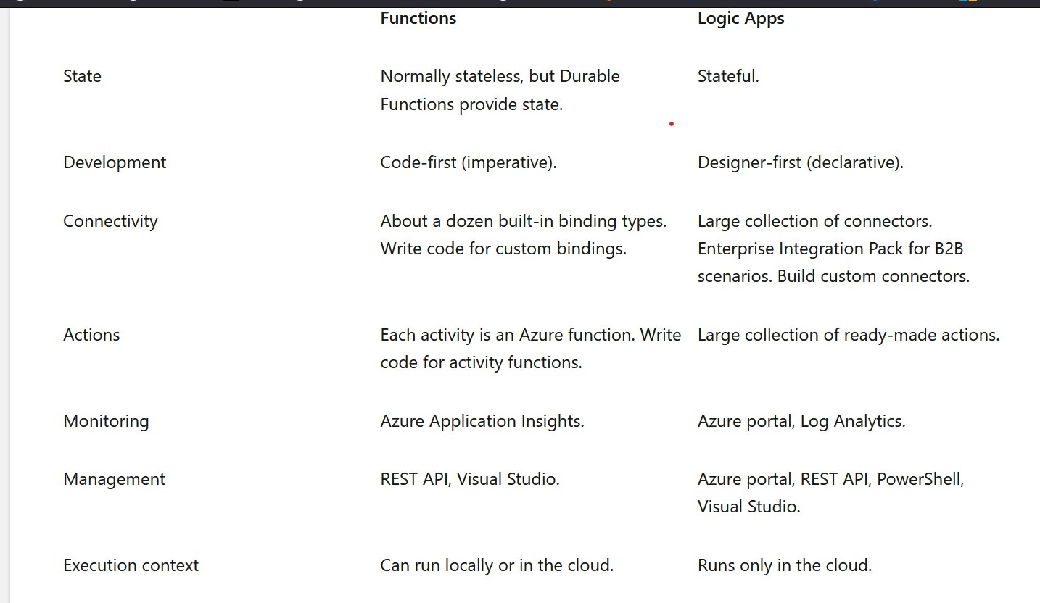

Slide 47
What can Azure Key Vault do?
Azure Key Vault can help you:
Manage secrets
You can use Key Vault to securely store and tightly control access to tokens, passwords, certificates, API keys, and other secrets.
Manage encryption keys
You can use Key Vault as a key management solution. Key Vault makes it easier to create and control the encryption keys that are used to encrypt your data.
Manage SSL/TLS certificates
Key Vault enables you to provision, manage, and deploy your public and private Secure Sockets Layer/Transport Layer Security (SSL/TLS) certificates for both your Azure resources and your internal resources.
Store secrets backed by hardware security modules (HSMs)
These secrets and keys can be protected either by software or by FIPS 140-2 Level 2 validated HSMs

Slide 48
What are the benefits of Azure Key Vault?
The benefits of using Key Vault include:
Centralized application secrets
Centralizing the storage for your application secrets enables you to control their distribution, and reduces the chances that secrets are accidentally leaked.
Securely stored secrets and keys
Azure uses industry-standard algorithms, key lengths, and HSMs. Access to Key Vault requires proper authentication and authorization.
Access monitoring and access control
By using Key Vault, you can monitor and control access to your application secrets.
Simplified administration of application secrets
Key Vault makes it easier to enroll and renew certificates from public certificate authorities (CAs). You can also scale up and replicate content within regions and use standard certificate management tools.
Integration with other Azure services
You can integrate Key Vault with storage accounts, container registries, event hubs, and many more Azure services. These services can then securely reference the secrets stored in Key Vault.
In practice, there are several ways to add secrets to and read secrets from Key Vault. You can use the Azure portal, the Azure CLI, or Azure PowerShell. By using your favorite programming language, your applications can also securely access the secrets that they need.

Slide 49
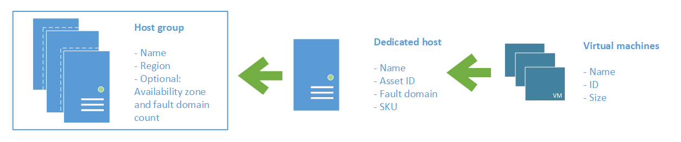
Dedicated Host
On Azure, virtual machines (VMs) run on shared hardware that Microsoft manages. Although the underlying hardware is shared, your VM workloads are isolated from workloads that other Azure customers run.
Some organizations must follow regulatory compliance that requires them to be the only customer using the
physical machine that hosts their virtual machines. Azure Dedicated Host provides dedicated physical servers
to host your Azure VMs for Windows and Linux.
Here's a diagram that shows how VMs relate to dedicated hosts and host groups. A dedicated host is mapped
to a physical server in an Azure datacenter. A host group is a collection of dedicated hosts.
What are the benefits of Azure Dedicated Host?

Slide 50
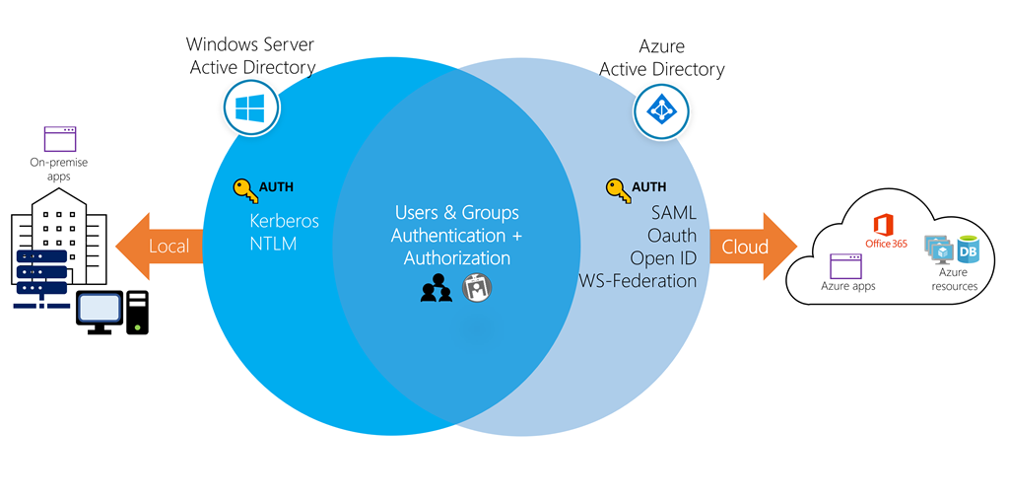

Slide 51
When a company or organization signs up to use one of these offerings, they are assigned a default directory, an instance of Azure AD. This directory holds the users and groups that will have access to each of the services the company has purchased. This default directory can be referred to as a tenant. A tenant represents the organization and the default directory assigned to it
Resources such as virtual machines, websites, and databases are associated with a single subscription. Each subscription also has a single account owner responsible for any charges incurred by resources in that subscription. If your organization wants a subscription billed to another account, you can transfer the subscription. A subscription is associated with a single Azure AD directory. Multiple subscriptions can trust the same directory, but a subscription can only trust one directory.
An Azure AD directory can be associated with multiple subscriptions, but a subscription is always tied to a single directory

Slide 52
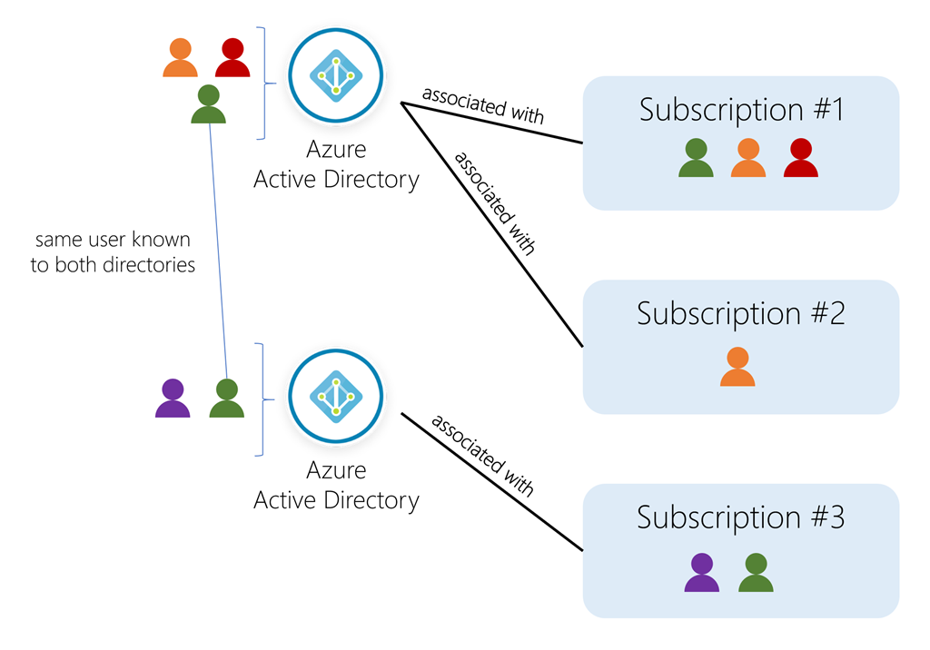

Slide 53
Azure AD Connect is a separate service that allows you to synchronize a traditional Active Directory with your Azure AD instance. This is how most enterprise customers add users to the directory. The advantage to this approach is users can use single sign-on (SSO) to access local and cloud-based resource
With Azure AD Connect, you can provide your users with a common identity for Microsoft 365, Azure, and SaaS applications integrated with Azure AD in a hybrid identity environment.

Slide 54
Azure Active Directory is the hub for user management in the cloud. It provides a single-sign on capability that makes it easier to onboard new employees and ensure you remove access from previous employees. It integrates tightly with your on-premise Windows Server Active Directory so you have a seamless login experience across all your local and cloud-based resources, and it integrates with other cloud environments like Salesforce, Microsoft 365, Dropbox, or Google. Finally, it can reduce your IT burden through its centralized management portal, support for self-service password resets, multi-factor authentication for increased security, high-reliability, and support for managing users and groups with roles

Slide 55
Azure offers both free and paid subscription options to fit your needs and requirements. They are:
Free trial
A free trial subscription provides you with 12 months of popular free services, a credit to explore any Azure service for 30 days, and more than 25 services that are always free. Your Azure services are disabled when the trial ends or when your credit expires for paid products, unless you upgrade to a paid subscription.
Pay-as-you-go
A pay-as-you-go subscription enables you to pay for what you use by attaching a credit or debit card to your account. Organizations can apply for volume discounts and prepaid invoicing.
Member offers
Your existing membership to certain Microsoft products and services might provide you with credits for your Azure account and reduced rates on Azure services. For example, member offers are available to Visual Studio subscribers, Microsoft Partner Network members, Microsoft for Startups members, and Microsoft Imagine members

Slide 56
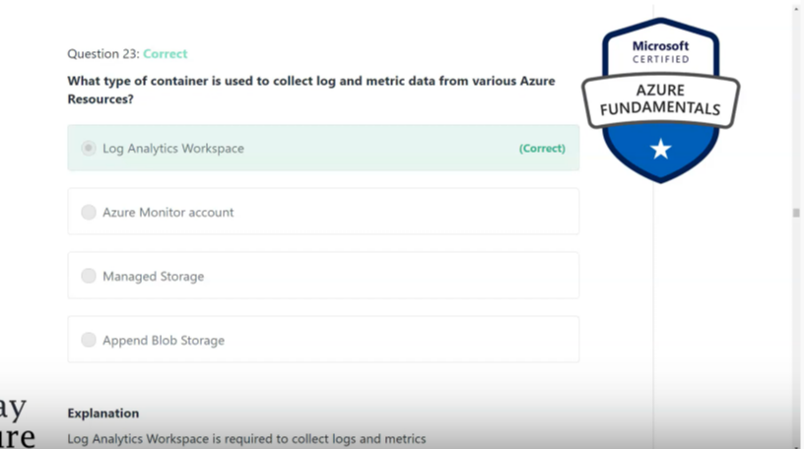

Slide 57
Resource usage
In Azure, you're always charged based on what you use. As an example, let's look at how this billing applies to deallocating a VM.
In Azure, you can delete or deallocate a VM. Deleting a VM means that you no longer need it. The VM is removed from your subscription, and then it's prepared for another customer.
Deallocating a VM means that the VM is no longer running. But the associated hard disks and data are still kept in Azure. The VM isn't assigned to a CPU or network in Azure's datacenter, so it doesn't generate the costs associated with compute time or the VM's IP address. Because the disks and data are still stored, and the resource is present in your Azure subscription, you're still billed for disk storage.

Slide 58
Bandwidth refers to data moving in and out of Azure datacenters.
Some inbound data transfers (data going into Azure datacenters) are free.
For outbound data transfers (data leaving Azure datacenters), data transfer pricing is based on zones.
A zone is a geographical grouping of Azure regions for billing purposes. The following zones include some of the regions as shown here:
Zone 1: Australia Central, West US, East US, Canada West, West Europe, France Central, and others
Zone 2: Australia East, Japan West, Central India, Korea South, and others
Zone 3: Brazil South, South Africa North, South Africa West, UAE Central, UAE North
DE Zone 1: Germany Central, Germany Northeast

Slide 59
Azure Advisor identifies unused or underutilized resources and recommends unused resources that you can remove. This information helps you configure your resources to match your actual workload.

Slide 60
A related concept is quotas, or limits on the number of similar resources you can provision within your subscription. For example, you can allocate up to 25,000 VMs per region. These limits mainly help Microsoft plan its datacenter capacity.
Tags help you manage costs associated with the different groups of Azure products and resources. You can apply tags to groups of Azure resources to organize billing data.
For example, if you run several VMs for different teams, you can use tags to categorize costs by department, such as Human Resources, Marketing, or Finance, or by environment, such as Test or Production.
Tags make it easier to identify groups that generate the biggest Azure costs, which can help you adjust your spending accordingly.

Slide 61
Resource groups are a fundamental element of the Azure platform.
A resource group is a logical container for resources deployed on Azure. These resources are anything you create in an Azure subscription like virtual machines, Application Gateways, and CosmosDB instances.
All resources must be in a resource group and a resource can only be a member of a single resource group.
Many resources can be moved between resource groups with some services having specific limitations or requirements to move.
Resource groups can't be nested. Before any resource can be provisioned, you need a resource group for it to be placed in
By applying RBAC permissions (role-based access control) to a resource group, you can ease administration and limit access to allow only what is needed

Slide 62
Resource groups can be created by using the following methods:
Azure portal
Azure PowerShell
Azure CLI
Templates
Azure SDKs (like .NET, Java)
A resource can have up to 50 tags
The name is limited to 512 characters for all types of resources except storage accounts, which have a limit of 128 characters. The tag value is limited to 256 characters for all types of resources. Tags aren't inherited from parent resources. Not all resource types support tags, and tags can't be applied to classic resource
Tags can be added and manipulated through the Azure portal, Azure CLI, Azure PowerShell, Resource Manager templates, and through the REST API.
Tags enable you to retrieve related resources from different resource groups. This approach is helpful when you need to organize resources for billing or management.

Slide 63
Azure Policy is a service you can use to create, assign, and manage policies.
These policies apply and enforce rules that your resources need to follow. These policies can enforce these rules when resources are created, and can be evaluated against existing resources to give visibility into compliance.
Policies can enforce things such as only allowing specific types of resources to be created, or only allowing resources in specific Azure regions. You can enforce naming conventions across your Azure environment. You can also enforce that specific tags are applied to resources
Policies can be created and assigned through the Azure portal, Azure PowerShell, or Azure CLI

Slide 64
RBAC provides fine-grained access management for Azure resources, enabling you to grant users the specific rights they need to perform their jobs. RBAC is considered a core service and is included with all subscription levels at no cost.
Using RBAC, you can:
Allow one user to manage VMs in a subscription, and another user to manage virtual networks.
Allow a database administrator (DBA) group to manage SQL databases in a subscription.
Allow a user to manage all resources in a resource group, such as VMs, websites, and virtual subnets.
Allow an application to access all resources in a resource group

Slide 65
Resource locks are a setting that can be applied to any resource to block modification or deletion.
Resource locks can set to either Delete or Read-only. Delete will allow all operations against the resource but block the ability to delete it.
Read-only will only allow read activities to be performed against it, blocking any modification or deletion of the resource.
Resource locks can be applied to subscriptions, resource groups, and to individual resources, and are inherited when applied at higher levels.

Slide 66
Tags can’t be applied to all resources
Tags applied at a resource group level cannot be propagated to resources within the resource group
Resource groups can’t be nested

Slide 67
these resources can be moved:
Azure Storage accounts
Azure virtual machines
Azure virtual networks
These resources can't be moved:
Azure Active Directory domain services
Azure Backup vaults
Azure App Service gateways

Slide 68
The Azure CLI is a command-line program to connect to Azure and execute administrative commands on Azure resources.
It runs on Linux, macOS, and Windows and allows administrators and developers to execute their commands through a terminal or command-line prompt (or script!) instead of a web browser
The Azure CLI provides cross-platform command-line tools for managing Azure resources, and can be installed locally on Linux, Mac, or Windows computers.
The Azure CLI can also be used from a browser through the Azure Cloud Shell. In both cases, it can be used interactively or scripted.
For interactive use, you first launch a shell such as cmd.exe on Windows or Bash on Linux or macOS and then issue the command at the shell prompt.
To automate repetitive tasks, you assemble the CLI commands into a shell script using the script syntax of your chosen shell and then execute the script.

Slide 70


Slide 73
No SLA is provided for the Free tier of Azure Active Directory.
Monthly Uptime Percentage | Service Credit
< 99.9% | 25%
< 99% | 50%
< 95% | 100%

Slide 74
Data Transfer In | Free
Data transfer between Availability Zones* | £0.008 per GB
Data transfer within same Availability Zone | Free
Data transfer from Azure origin to Azure CDN | Free

Slide 75
Azure Reservations help you save money by committing to one-year or three-year plans for multiple products. Committing allows you to get a discount on the resources you use. Reservations can significantly reduce your resource costs by up to 72% from pay-as-you-go prices. Reservations provide a billing discount and don't affect the runtime state of your resources. After you purchase a reservation, the discount automatically applies to matching resources.
You can pay for a reservation up front or monthly. The total cost of up-front and monthly reservations is the same and you don't pay any extra fees when you choose to pay monthly. Monthly payment is available for Azure reservations, not third-party products.

Slide 76
One of the benefits of Azure SQL Data Warehouse is that high availability is built into the platform. Instructions: Review the underlined text. If it makes the statement correct, select “No change is needed”. If the statement is incorrect, select the answer choice that makes the statement correct.
No change is needed
automatic scaling
data compression
versioning

Slide 77
You have an Azure environment that contains multiple Azure virtual machines. You plan to implement a solution that enables the client computers on your on-premises network to
communicate to the Azure virtual machines. You need to recommend which Azure resources must be created for the planned solution. Which two Azure resources should you include in the recommendation? Each correct answer presents
part of the solution. NOTE: Each correct selection is worth one point.
a virtual network gateway
a load balancer
an application gateway
a virtual network
a gateway subnet

Slide 78
What can Azure Information Protection encrypt?
an Azure Storage account
documents and email messages
an Azure SQL database
network traffic

Slide 79
You have several virtual machines in an Azure subscription. You create a new subscription. The virtual machines cannot be moved to the new subscription. Instructions: Review the underlined text. If it makes the statement correct, select “No change is needed”. If the statement is incorrect, select the answer choice that makes the statement correct.
No change is needed
The virtual machines can be moved to the new subscription
The virtual machines can be moved to the new subscription only if they are all in the same resource group
The virtual machines can be moved to the new subscription only if they run Windows Server 2016.

Slide 80


Slide 81


Slide 82
Your company has a Software Assurance agreement that includes Microsoft SQL Server licenses You plan to deploy SQL Server on Azure virtual machines. What should you do to minimize licensing costs for the deployment?
Use Azure reservations.
Use Azure Hybrid Benefit
Deallocate the virtual machines during off hours.
Configure Azure Cost Management budgets.

Slide 83
If a resource group named RG1 has a delete lock, only a member of the global administrators group can delete RG1.
Instructions: Review the underlined text. If it makes the statement correct, select “No change is needed”. If the statement is incorrect, select the answer choice that makes the statement correct.
No change is needed
the delete lock must be removed before an administrator can delete RG1.
an Azure policy must be modified before an administrator can delete RG1.
an Azure tag must be added before an administrator can delete RG1.

Slide 84


Slide 85


Slide 86


Slide 88


Slide 89


Slide 90
Your company implements Azure policies to automatically add a watermark to Microsoft Word documents that contain
credit card information. Instructions: Review the underlined text. If it makes the statement correct, select “No change is needed”. If the
statement is incorrect,
select the answer choice that makes the statement correct.
No change is needed.
DDoS protection
Azure Information Protection
Azure Active Directory (Azure AD) Identity Protection

Slide 91
If Microsoft plans to end support for an Azure service that does NOT have a successor service, Microsoft will provide notification at least 12 months before.
Instructions: Review the underlined text. If it makes the statement correct, select “No change is needed”. If the statement is incorrect, select the answer choice that makes the statement correct.
No change is needed.
6 months
90 days
30 days

Slide 92
What can you use to automatically send an alert if an administrator stops an Azure virtual machine?
Azure Advisor
Azure Service Health
Azure Monitor
Azure Network Watcher

Slide 93


Slide 94
When you want to delete the resource, you first need to remove the lock. A lock cannot be removed with an ARM template. To remove the lock you can use:
PowerShell
Rest API
Portal
Only the roles Owner and User Access Administrator can delete the locks on the resources. After the lock is removed the resource can be delete as any other resource.

Slide 95


Slide 96

Each resource can exist in only one resource group

Slide 97


Slide 98


Slide 99

Box 1: No - An Azure AD tenant can have multiple subscriptions but an Azure subscription can only be associated with one Azure AD tenant. Box 2: Yes - Box 3: No - If your subscription expires, you lose access to all the other resources associated with the subscription. However, the Azure AD directory remains in Azure. You can associate and manage the directory using a different Azure subscription. References: https://docs.microsoft.com/en-us/azure/active-directory/fundamentals/active-directory-how-subscriptions-associated-directory

Slide 100
An Azure subscription has a trust relationship with Azure Active Directory (Azure AD). A subscription trusts Azure AD to authenticate users, services, and devices.
Multiple subscriptions can trust the same Azure AD directory. Each subscription can only trust a single directory.
One or more Azure subscriptions can establish a trust relationship with an instance of Azure Active Directory (Azure AD) in order to authenticate and authorize security principals and devices against Azure services. When a subscription expires, the trusted instance of the Azure AD service remains, but the security principals lose access to Azure resources.
When a user signs up for a Microsoft cloud service, a new Azure AD tenant is created and the user is made a member of the Global Administrator role. However, when an owner of a subscription joins their subscription to an existing tenant, the owner isn't assigned to the Global Administrator role.

Slide 101


Slide 102


Slide 103
Your company plans to move several servers to Azure. The companyג€™s compliance policy states that a server named FinServer must be on a separate network segment. You are evaluating which Azure services can be used to meet the compliance policy requirements. Which Azure solution should you recommend?
A. a resource group for FinServer and another resource group for all the other servers
B. a virtual network for FinServer and another virtual network for all the other servers
C. a VPN for FinServer and a virtual network gateway for each other server
D. one resource group for all the servers and a resource lock for FinServer
Networks in Azure are known as virtual networks. A virtual network can have multiple IP address spaces and multiple subnets. Azure automatically routes traffic between different subnets within a virtual network. The question states that FinServer must be on a separate network segment. The only way to separate FinServer from the other servers in networking terms is to place the server in a different virtual network to the other servers. References: https://docs.microsoft.com/en-us/azure/virtual-network/virtual-network-vnet-plan-design-arm

Slide 104
You plan to map a network drive from several computers that run Windows 10 to Azure Storage. You need to create a storage solution in Azure for the planned mapped drive. What should you create?
A. an Azure SQL database
B. a virtual machine data disk
C. a Files service in a storage account
D. a Blobs service in a storage account

Slide 105
Your company plans to migrate all its network resources to Azure. You need to start the planning process by exploring Azure. What should you create first?
A. a subscription
B. a resource group
C. a virtual network
D. a management group
The first thing you create in Azure is a subscription. You can think of an Azure subscription as an ג€˜Azure accountג€™. You get billed per subscription. A subscription is an agreement with Microsoft to use one or more Microsoft cloud platforms or services, for which charges accrue based on either a per-user license fee or on cloud-based resource consumption. Microsoft's Software as a Service (SaaS)-based cloud offerings (Office 365, Intune/EMS, and Dynamics 365) charge per-user license fees. Microsoft's Platform as a Service (PaaS) and Infrastructure as a Service (IaaS) cloud offerings (Azure) charge based on cloud resource consumption

Slide 106

Azure resources deployed to a single resource group can be located in different regions. The resource group only contains metadata about the resources it contains. When creating a resource group, you need to provide a location for that resource group. You may be wondering, "Why does a resource group need a location? And, if the resources can have different locations than the resource group, why does the resource group location matter at all?" The resource group stores metadata about the resources. When you specify a location for the resource group, you're specifying where that metadata is stored. For compliance reasons, you may need to ensure that your data is stored in a particular region. Box 2: No - Tags for Resources are not inherited by default from their Resource Group Box 3: Yes - A resource group can be used to scope access control for administrative actions. By default, permissions set at the resource level are inherited by the resources in the resource group.

Slide 107

Azure storage offers different access tiers: hot, cool and archive. The archive access tier has the lowest storage cost. But it has higher data retrieval costs compared to the hot and cool tiers. Data in the archive tier can take several hours to retrieve. While a blob is in archive storage, the blob data is offline and can't be read, overwritten, or modified. To read or download a blob in archive, you must first rehydrate it to an online tier. Example usage scenarios for the archive access tier include: ✑ Long-term backup, secondary backup, and archival datasets ✑ Original (raw) data that must be preserved, even after it has been processed into final usable form. ✑ Compliance and archival data that needs to be stored for a long time and is hardly ever accessed.

Slide 108
Which Azure service should you use to collect events from multiple resources into a centralized repository?
A. Azure Event Hubs
B. Azure Analysis Services
C. Azure Monitor
D. Azure Stream Analytics
Azure Event Hubs is a big data streaming platform and event ingestion service. It can receive and process millions of events per second. Data sent to an event hub can be transformed and stored by using any real-time analytics provider or batching/storage adapters. Azure Event Hubs can be used to ingest, buffer, store, and process your stream in real time to get actionable insights. Event Hubs uses a partitioned consumer model, enabling multiple applications to process the stream concurrently and letting you control the speed of processing. Azure Event Hubs can be used to capture your data in near-real time in an Azure Blob storage or Azure Data Lake Storageג€‰for long-term retention or micro-batch processing.

Slide 109


Slide 110
You need to be notified when Microsoft plans to perform maintenance that can affect the resources deployed to an Azure subscription. What should you use?
A. Azure Monitor
B. Azure Service Health
C. Azure Advisor
D. Microsoft Trust Center
Azure Service Health provides a personalized view of the health of the Azure services and regions you're using. This is the best place to look for service impacting communications about outages, planned maintenance activities, and other health advisories because the authenticated Service Health experience knows which services and resources you currently use

Slide 111


Slide 112
Azure IoT Central is a software as a service (SaaS) solution that uses a model-based approach to help you to build enterprise-grade IoT solutions without requiring expertise in cloud-solution development.
IoT Hub is a managed service hosted in the cloud that acts as a central message hub for communications in both directions between an IoT application and its attached devices. You can connect millions of devices and their backend solutions reliably and securely. Almost any device can be connected to an IoT Hub.
Azure Sphere is a secured, high-level application platform with built-in communication and security features for internet-connected devices. It comprises a secured, connected, crossover microcontroller unit (MCU), a custom high-level Linux-based operating system (OS), and a cloud-based security service that provides continuous, renewable security

Slide 113


Slide 114


Slide 115


Slide 116
You have an Azure subscription named Subscription1. You sign in to the Azure portal and create a resource group named RG1. From Azure documentation, you have the following command that creates a virtual machine named VM1. az vm create --resource-group RG1 --name VM1 --image UbuntuLTS --generate-ssh-keys You need to create VM1 in Subscription1 by using the command. Solution: From the Azure portal, launch Azure Cloud Shell and select Bash. Run the command in Cloud Shell. Does this meet the goal?
A. Yes
B. No
The command can be run in the Azure Cloud Shell. The Azure Cloud Shell is a free interactive shell. It has common Azure tools preinstalled and configured to use with your account. To open the Cloud Shell, just select Try it from the upper right corner of a code block. You can also launch Cloud Shell in a separate browser tab by going to https://shell.azure.com/bash.

Slide 117
Your company has several business units. Each business unit requires 20 different Azure resources for daily operation. All the business units require the same type of Azure resources. You need to recommend a solution to automate the creation of the Azure resources. What should you include in the recommendations?
A. Azure Resource Manager templates
B. virtual machine scale sets
C. the Azure API Management service
D. management groups
You can use Azure Resource Manager templates to automate the creation of the Azure resources. Deploying resource through templates is known as ג€˜Infrastructure as codeג€™. To implement infrastructure as code for your Azure solutions, use Azure Resource Manager templates. The template is a JavaScript Object Notation (JSON) file that defines the infrastructure and configuration for your project. The template uses declarative syntax, which lets you state what you intend to deploy without having to write the sequence of programming commands to create it

Slide 118

Azure Functions provides the platform for serverless code. Azure Functions is a serverless compute service that lets you run event-triggered code without having to explicitly provision or manage infrastructure. Box 2: Azure Databricks is a big analysis service for machine learning. Azure Databricks is an Apache Spark-based analytics platform. The platform consists of several components including ג€˜MLibג€™. Mlib is a Machine Learning library consisting of common learning algorithms and utilities
Box 3: Azure Application Insights detects and diagnoses anomalies in web apps. Application Insights, a feature of Azure Monitor, is an extensible Application Performance Management (APM) service for developers and DevOps professionals. Use it to monitor your live applications. It will automatically detect performance anomalies, and includes powerful analytics tools to help you diagnose issues Box 4: Azure App Service hosts web apps. Azure App Service is an HTTP-based service for hosting web applications, REST APIs, and mobile back ends. You can develop in your favorite language, be it .NET, .NET Core, Java, Ruby, Node.js, PHP, or Python. Applications run and scale with ease on both Windows and Linux

Slide 119
Azure Functions provides the platform for serverless code. Azure Functions is a serverless compute service that lets you run event-triggered code without having to explicitly provision or manage infrastructure. Box 2: Azure Databricks is a big analysis service for machine learning. Azure Databricks is an Apache Spark-based analytics platform. The platform consists of several components including ג€˜MLibג€™. Mlib is a Machine Learning library consisting of common learning algorithms and utilities, including classification, regression, clustering, collaborative filtering, dimensionality reduction, as well as underlying optimization primitives. Box 3: Azure Application Insights detects and diagnoses anomalies in web apps. Application Insights, a feature of Azure Monitor, is an extensible Application Performance Management (APM) service for developers and DevOps professionals. Use it to monitor your live applications. It will automatically detect performance anomalies, and includes powerful analytics tools to help you diagnose issues and to understand what users actually do with your app. Box 4: Azure App Service hosts web apps. Azure App Service is an HTTP-based service for hosting web applications, REST APIs, and mobile back ends. You can develop in your favorite language, be it .NET, .NET Core, Java, Ruby, Node.js, PHP, or Python. Applications run and scale with ease on both Windows and Linux

Slide 120


Slide 121
A team of developers at your company plans to deploy, and then remove, 50 customized virtual machines each week. Thirty of the virtual machines run Windows
Server 2016 and 20 of the virtual machines run Ubuntu Linux.
You need to recommend which Azure service will minimize the administrative effort required to deploy and remove the virtual machines.
What should you recommend?
A. Azure Reserved Virtual Machines (VM) Instances
B. Azure virtual machine scale sets
C. Azure DevTest Labs
D. Microsoft Managed Desktop
DevTest Labs creates labs consisting of pre-configured bases or Azure Resource Manager templates. By using DevTest Labs, you can test the latest versions of your applications by doing the following tasks: ✑ Quickly provision Windows and Linux environments by using reusable templates and artifacts. ✑ Easily integrate your deployment pipeline with DevTest Labs to provision on-demand environments. ✑ Scale up your load testing by provisioning multiple test agents and create pre-provisioned environments for training and demos.

Slide 122


Slide 123
You have a virtual machine named VM1 that runs Windows Server 2016. VM1 is in the East US Azure region. Which Azure service should you use from the Azure portal to view service failure notifications that can affect the availability of VM1?
A. Azure Service Fabric
B. Azure Monitor
C. Azure virtual machines
D. Azure Advisor
In the Azure virtual machines page in the Azure portal, there is a named Maintenance Status. This column will display service issues that could affect your virtual machine. A service failure is rare but host server maintenance that could affect your virtual machines is more common. Azure periodically updates its platform to improve the reliability, performance, and security of the host infrastructure for virtual machines. The purpose of these updates ranges from patching software components in the hosting environment to upgrading networking components or decommissioning hardware

Slide 124
An Azure administrator plans to run a PowerShell script that creates Azure resources. You need to recommend which computer configuration to use to run the script. Solution: Run the script from a computer that runs Linux and has the Azure CLI tools installed. Does this meet the goal?
A. Yes
B. No
A PowerShell script is a file that contains PowerShell cmdlets and code. A PowerShell script needs to be run in PowerShell. PowerShell can now be installed on Linux. However, the question states that the computer has Azure CLI tools, not PowerShell installed. Therefore, this solution does not meet the goal

Slide 125
An Azure administrator plans to run a PowerShell script that creates Azure resources. You need to recommend which computer configuration to use to run the script. Solution: Run the script from a computer that runs Chrome OS and uses Azure Cloud Shell. Does this meet the goal?
A. Yes
B. No
A PowerShell script is a file that contains PowerShell cmdlets and code. A PowerShell script needs to be run in PowerShell. With the Azure Cloud Shell, you can run PowerShell cmdlets and scripts in a Web browser. You log in to the Azure Portal and select the Azure Cloud Shell option. This will open a PowerShell session in the Web browser. The Azure Cloud Shell has the necessary Azure PowerShell module installed. Note: to run a PowerShell script in the Azure Cloud Shell, you need to change to the directory where the PowerShell script is stored.

Slide 126

Azure Service Health consists of three components: Azure Status, Azure Service Heath and Azure Resource Health. Azure service health provides a personalized view of the health of the Azure services and regions you're using. This is the best place to look for service impacting communications about outages, planned maintenance activities, and other health advisories because the authenticated Azure Service Health experience knows which services and resources you currently use.
Box 2: Yes - The best way to use Service Health is to set up Service Health alerts to notify you via your preferred communication channels when service issues, planned maintenance, or other changes may affect the Azure services and regions you use. Box 3: No - You can use Resource Health to view the health of a virtual machine. However, you cannot use Resource Health to prevent a service failure affecting the virtual machine.

Slide 127

Azure Application Insights detects and diagnoses anomalies in web apps
Azure Advisor is a personalized cloud consultant that helps you follow best practices to optimize your Azure deployments. It analyzes your resource configuration and usage telemetry and then recommends solutions that can help you improve the cost effectiveness, performance, high availability, and security of your Azure resources

Slide 128

SQL Server is a relational database service. Azure SQL Database is a managed SQL Server Database in Azure Box 2: Azure SQL Synapse Analytics Azure SQL Synapse Analytics (previously called Data Warehouse) is a cloud-based Platform-as-a-Service (PaaS) offering from Microsoft. It is a large-scale, distributed, MPP (massively parallel processing) relational database technology
Synapse Analytics is an important component of the Modern Data Warehouse multi-platform architecture. Because Azure SQL Synapse Analytics is an MPP system with a shared-nothing architecture across distributions, it is meant for large-scale analytical workloads which can take advantage of parallelism. Box 3: Azure Data Lake Analytics You can process big data jobs in seconds with Azure Data Lake Analytics. You can process petabytes of data for diverse workload categories such as querying,ETL, analytics, machine learning, machine translation, image processing and sentiment analysis by leveraging existing libraries written in .NET languages, R orPython.
Box 4: Azure HDInsight. Apache Hadoop was the original open-source framework for distributed processing and analysis of big data sets on clusters. The Hadoop ecosystem Azure HDInsight is a fully managed, full-spectrum, open-source analytics service in the cloud for enterprises.

Slide 129
You have an on-premises application that sends email notifications automatically based on a rule. You plan to migrate the application to Azure. You need to recommend a serverless computing solution for the application. What should you include in the recommendation?
A. a web app
B. a server image in Azure Marketplace
C. a logic app
D. an API app
Azure Logic Apps is a cloud service that helps you schedule, automate, and orchestrate tasks, business processes, and workflows when you need to integrate apps, data, systems, and services across enterprises or organizations.
Logic Apps simplifies how you design and build scalable solutions for app integration, data integration, system integration, enterprise application integration (EAI), and business-to-business (B2B) communication, whether in the cloud, on premises, or both.
For example, here are just a few workloads you can automate with logic apps: ✑ Process and route orders across on-premises systems and cloud services. ✑ Send email notifications with Office 365 when events happen in various systems, apps, and services. ✑ Move uploaded files from an SFTP or FTP server to Azure Storage. ✑ Monitor tweets for a specific subject, analyze the sentiment, and create alerts or tasks for items that need review.

Slide 130
Your company plans to deploy several million sensors that will upload data to Azure. You need to identify which Azure resources must be created to support the planned solution. Which two Azure resources should you identify? Each correct answer presents part of the solution. NOTE: Each correct selection is worth one point.
A. Azure Data Lake
B. Azure Queue storage
C. Azure File Storage
D. Azure IoT Hub
E. Azure Notification Hubs
IoT Hub (Internet of things Hub) provides data from millions of sensors. IoT Hub is a managed service, hosted in the cloud, that acts as a central message hub for bi-directional communication between your IoT application and the devices it manages.
There are two storage services IoT Hub can route messages to -- Azure Blob Storage and Azure Data Lake Storage Gen2 (ADLS Gen2) accounts. Azure Data Lake Storage accounts are hierarchical namespace-enabled storage accounts built on top of blob storage. Both of these use blobs for their storage.

Slide 131

Azure Advisor does not generate a list of virtual machines that ARE protected by Azure Backup. Azure Advisor does however, generate a list of virtual that ARE NOT protected by Azure Backup. You can view a list of virtual machines that are protected by Azure Backup by viewing the Protected Items in the Azure Recovery Services Vault. Box 2: No - If you implement the security recommendations, you companyג€™s score will increase, not decrease. Box 3: No - There is no requirement to implement the security recommendations provided by Azure Advisor. The recommendations are just that, ג€˜recommendationsג€™. They are not ג€˜requirementsג€™.

Slide 132
What can you use to automatically send an alert if an administrator stops an Azure virtual machine?
A. Azure Advisor
B. Azure Service Health
C. Azure Monitor
D. Azure Network Watcher

Slide 133


Slide 134
You have an Azure environment.
You need to create a new Azure virtual machine from a tablet that runs the Android operating system.
What are three possible solutions? Each correct answer presents a complete solution.
NOTE: Each correct selection is worth one point.
A. Use Bash in Azure Cloud Shell.
B. Use PowerShell in Azure Cloud Shell.
C. Use the PowerApps portal.
D. Use the Security & Compliance admin center.
E. Use the Azure portal.

Slide 135

Box 1: No - Azure Advisor provides you with a consistent, consolidated view of recommendations for all your Azure resources. It integrates with Azure Security Center to bring you security recommendations. You can get security recommendations from the Security tab on the Advisor dashboard. Examples of recommendations include restricting access to virtual machines by configuring Network Security Groups, enabling storage encryption, installing vulnerability assessment solutions. However, Azure Advisor does not provide recommendations on how to improve the security of an Azure AD environment. Box 2: Yes - Advisor helps you optimize and reduce your overall Azure spend by identifying idle and underutilized resources. You can get cost recommendations from the Cost tab on the Advisor dashboard.
Box 3: No. Azure Advisor does not provide recommendations on how to configure network settings on Azure virtual machines.

Slide 136
You have an Azure subscription named Subscription1. You sign in to the Azure portal and create a resource group named RG1. From Azure documentation, you have the following command that creates a virtual machine named VM1. az vm create --resource-group RG1 --name VM1 --image UbuntuLTS --generate-ssh-keys You need to create VM1 in Subscription1 by using the command. Solution: From a computer that runs Windows 10, install Azure CLI. From PowerShell, sign in to Azure and then run the command. Does this meet the goal?
A. Yes
B. No
The command can be run from PowerShell or the command prompt if you have the Azure CLI installed. However, it must be run on the Windows 10 computer, not in Azure

Slide 137
You have an Azure subscription named Subscription1. You sign in to the Azure portal and create a resource group named RG1. From Azure documentation, you have the following command that creates a virtual machine named VM1. az vm create --resource-group RG1 --name VM1 --image UbuntuLTS --generate-ssh-keys You need to create VM1 in Subscription1 by using the command. Solution: From the Azure portal, launch Azure Cloud Shell and select PowerShell. Run the command in Cloud Shell. Does this meet the goal?
A. Yes
B. No

Slide 138
You have an Azure subscription named Subscription1. You sign in to the Azure portal and create a resource group named RG1. From Azure documentation, you have the following command that creates a virtual machine named VM1. az vm create --resource-group RG1 --name VM1 --image UbuntuLTS --generate-ssh-keys You need to create VM1 in Subscription1 by using the command. Solution: From a computer that runs Windows 10, install Azure CLI. From a command prompt, sign in to Azure and then run the command. Does this meet the goal?
A. Yes
B. No
Hide Solution
The command can be run from PowerShell or the command prompt if you have the Azure CLI installed. However, it must be run on the Windows 10 computer, not in Azure

Slide 139

Azure Resource Manager templates provides a common platform for deploying objects to a cloud infrastructure and for implementing consistency across the Azure environment. Azure policies are used to define rules for what can be deployed and how it should be deployed. Whilst this can help in ensuring consistency, Azure policies do not provide the common platform for deploying objects to a cloud infrastructure.

Slide 140


Slide 141
An Azure administrator plans to run a PowerShell script that creates Azure resources. You need to recommend which computer configuration to use to run the script. Which three computers can run the script? Each correct answer presents a complete solution. NOTE: Each correct selection is worth one point.
A. a computer that runs macOS and has PowerShell Core 6.0 installed.
B. a computer that runs Windows 10 and has the Azure PowerShell module installed.
C. a computer that runs Linux and has the Azure PowerShell module installed.
D. a computer that runs Linux and has the Azure CLI tools installed.
E. a computer that runs Chrome OS and uses Azure Cloud Shell.
Hide Solution Discussion 28

Slide 142
ou need to configure an Azure solution that meets the following requirements: Secures websites from attacks - Generates reports that contain details of attempted attacks What should you include in the solution?
A. Azure Firewall
B. a network security group (NSG)
C. Azure Information Protection
D. DDoS protection
DDoS is a type of attack that tries to exhaust application resources. The goal is to affect the applicationג€™s availability and its ability to handle legitimate requests. DDoS attacks can be targeted at any endpoint that is publicly reachable through the internet. Azure has two DDoS service offerings that provide protection from network attacks: DDoS Protection Basic and DDoS Protection Standard. DDoS Basic protection is integrated into the Azure platform by default and at no extra cost. You have the option of paying for DDoS Standard. It has several advantages over the basic service, including logging, alerting, and telemetry. DDoS Standard can generate reports that contain details of attempted attacks as required in this question

Slide 143


Slide 144

The just-in-time (JIT) virtual machine (VM) access feature in Azure Security Center allows you to lock down inbound traffic to your Azure Virtual Machines. This reduces exposure to attacks while providing easy access when you need to connect to a VM.

Slide 145

You can associate zero, or one, network security group to each virtual network subnet and network interface in a virtual machine.

Slide 146
You plan to migrate a web application to Azure. The web application is accessed by external users. You need to recommend a cloud deployment solution to minimize the amount of administrative effort used to manage the web application. What should you include in the recommendation?
A. Software as a Service (SaaS)
B. Platform as a Service (PaaS)
C. Infrastructure as a Service (IaaS)
D. Database as a Service (DaaS)
Hide Solution
Azure App Service is a platform-as-a-service (PaaS) offering that lets you create web and mobile apps for any platform or device and connect to data anywhere, in the cloud or on-premises

Slide 147


Slide 148
You have an Azure environment. You need to create a new Azure virtual machine from a tablet that runs the Android operating system. Solution: You use PowerShell in Azure Cloud Shell. Does this meet the goal? A. Yes B. No
Azure Cloud Shell is a browser-based shell experience to manage and develop Azure resources. Cloud Shell offers a browser-accessible, pre-configured shell experience for managing Azure resources without the overhead of installing, versioning, and maintaining a machine yourself. Being browser-based, Azure Cloud Shell can be run on a browser from a tablet that runs the Android operating system.

Slide 149


Slide 150
You plan to deploy several Azure virtual machines.
You need to control the ports that devices on the internet can use to access the virtual machines.
What should you use?
an Azure Active Directory (AzureAD) role
an Azure key vault
an Azure Active Directory group
a network security group (NSG)

Slide 151


Slide 152
Your company has an Azure subscription that contains the following unused resources:
* 20 user accounts in Azure Active Directory (Azure AD)
* Five groups in Azure AD
* 10 public !P addresses
* 10 network interfaces
You need to reduce the Azure costs for the company.
Solution: You remove the unused public IP addresses.
Does this meet the goal?
Yes
No

Slide 153


Slide 154


Slide 155


Slide 156
Your company plans to migrate all its data and resources to Azure.
The company’s migration plan states that only platform as a service (PaaS) solutions must be used in Azure.
You need to deploy an Azure environment that supports the planned migration.
Solution: You create an Azure App Service and Azure Storage accounts.
Does this meet the goal?
Yes
No

Slide 157
When you need to delegate permissions to several Azure virtual machines simultaneously, you must deploy the Azure virtual machines to the same Azure region
Instructions: Review the underlined text If it makes the statement correct, select "No change is needed." If the statement is incorrect, select the answer choice that makes the statement correct.
No change is needed.
by using the same Azure Resource Manager template
to the same resource group
to the same availability zone

Slide 158


Slide 159
You have an on-premises application that sends email notifications automatically based on a rule.
You plan to migrate the application to Azure.
You need to recommend a serverless computing solution for the application.
What should you include in the recommendation?
a logic app
a server image in Azure Marketplace
an API app
a web app

Slide 160


Slide 161


Slide 162


Slide 163
Basic Request support | DEVELOPERPurchase support | STANDARDPurchase support | PROFESSIONAL DIRECTPurchase support
Price | Included for all Azure customers | £21.62 per month | £74.54 per month | £745.31 per month
Scope | Included for all Azure customers | Trial and non-production environments | Production workload environments | Business-critical dependence
Billing and subscription management support | Available | Available | Available | Available
24/7 self-help resources, including Microsoft Learn, Azure portal how-to videos, documentation and community support | Available | Available | Available | Available
Ability to submit as many support tickets as you need | Available | Available | Available | Available
Azure Advisor – your free, personalised guide to Azure best practices | Available | Available | Available | Available
Azure health status and notifications | Available | Available | Available | Available
Third-party software support with interoperability and configuration guidance and troubleshooting | Not available | Available | Available | Available
24/7 access to technical support by email and phone after a support request has been submitted | Not available | Available during business hours by email only. | Available | Available
Case severity and response time | Not available | Minimal business impact (Sev C): Within eight business hours¹ | Minimal business impact (Sev C): Within eight business hours¹Moderate business impact (Sev B): Within four hoursCritical business impact (Sev A): Within one hour | Minimal business impact (Sev C): Within four business hours¹Moderate business impact (Sev B): Within two hoursCritical business impact (Sev A): Within one hour
Architecture Support | Not available | General guidance | General guidance | Guidance from a pool of ProDirect delivery managers
Support API (see details) | Not available | Not available | Not available | Create and manage Azure support tickets programmatically
Operations Support | Not available | Not available | Not available | Service reviews and advisory consultation from a pool of ProDirect delivery managers are non-transferable and limited to Azure ProDirect customers only
Training | Not available | Not available | Not available | Webinars led by Azure engineers

Slide 164


Slide 165


Slide 166
Box 1: No - An Azure AD tenant can have multiple subscriptions but an Azure subscription can only be associated with one Azure AD tenant. Box 2: Yes - Box 3: No - If your subscription expires, you lose access to all the other resources associated with the subscription. However, the Azure AD directory remains in Azure. You can associate and manage the directory using a different Azure subscription. References: https://docs.microsoft.com/en-us/azure/active-directory/fundamentals/active-directory-how-subscriptions-associated-directory

